Slide 1





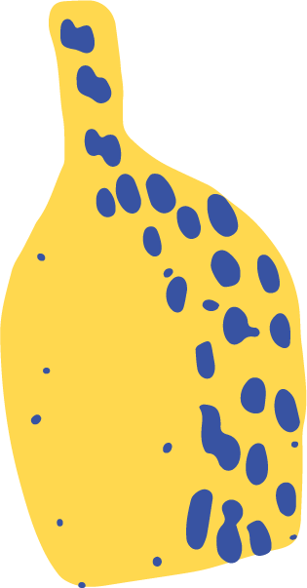
The Elements of Art
The building blocks of art

Slide 2
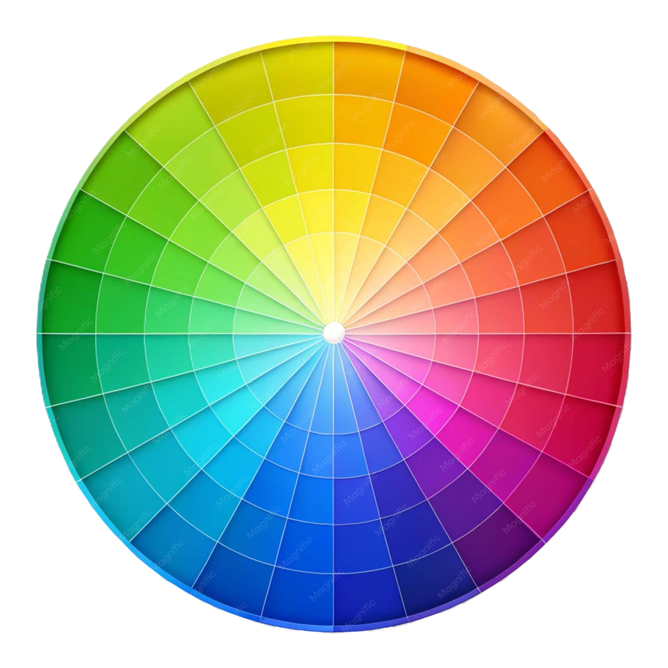
The Elements of Art
line
shape
form
Distance between two points
Enclosed line
(height x width)
Shape with depth
value
space
color
texture
Lightness/darkness
Depth, perspective and visual focus
Hue, brightness and saturation
Visual or physical surface quality

Slide 3
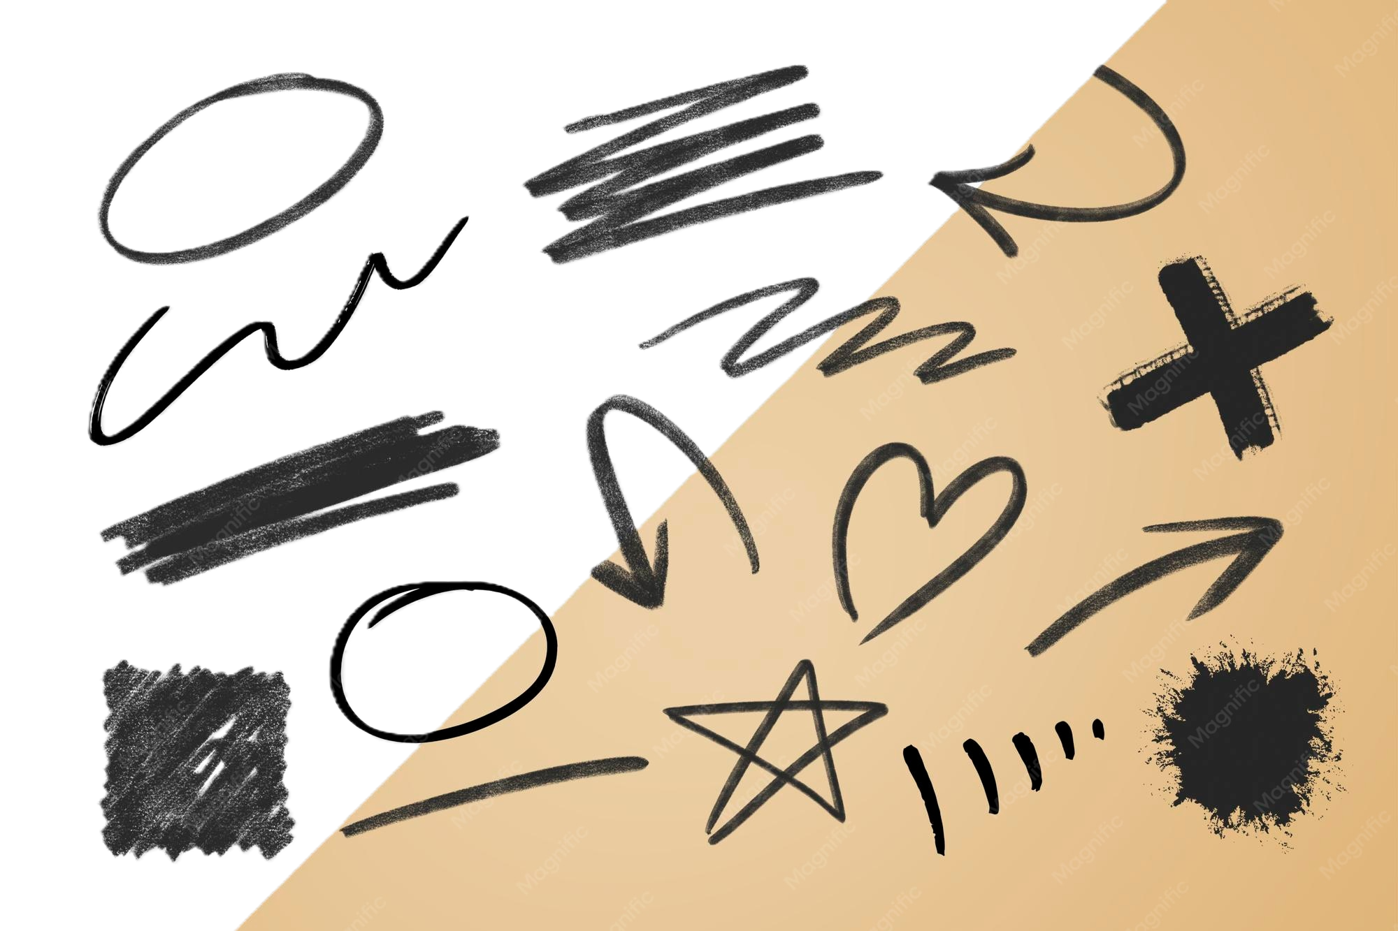
line
The element marking the distance between two points.

Slide 4
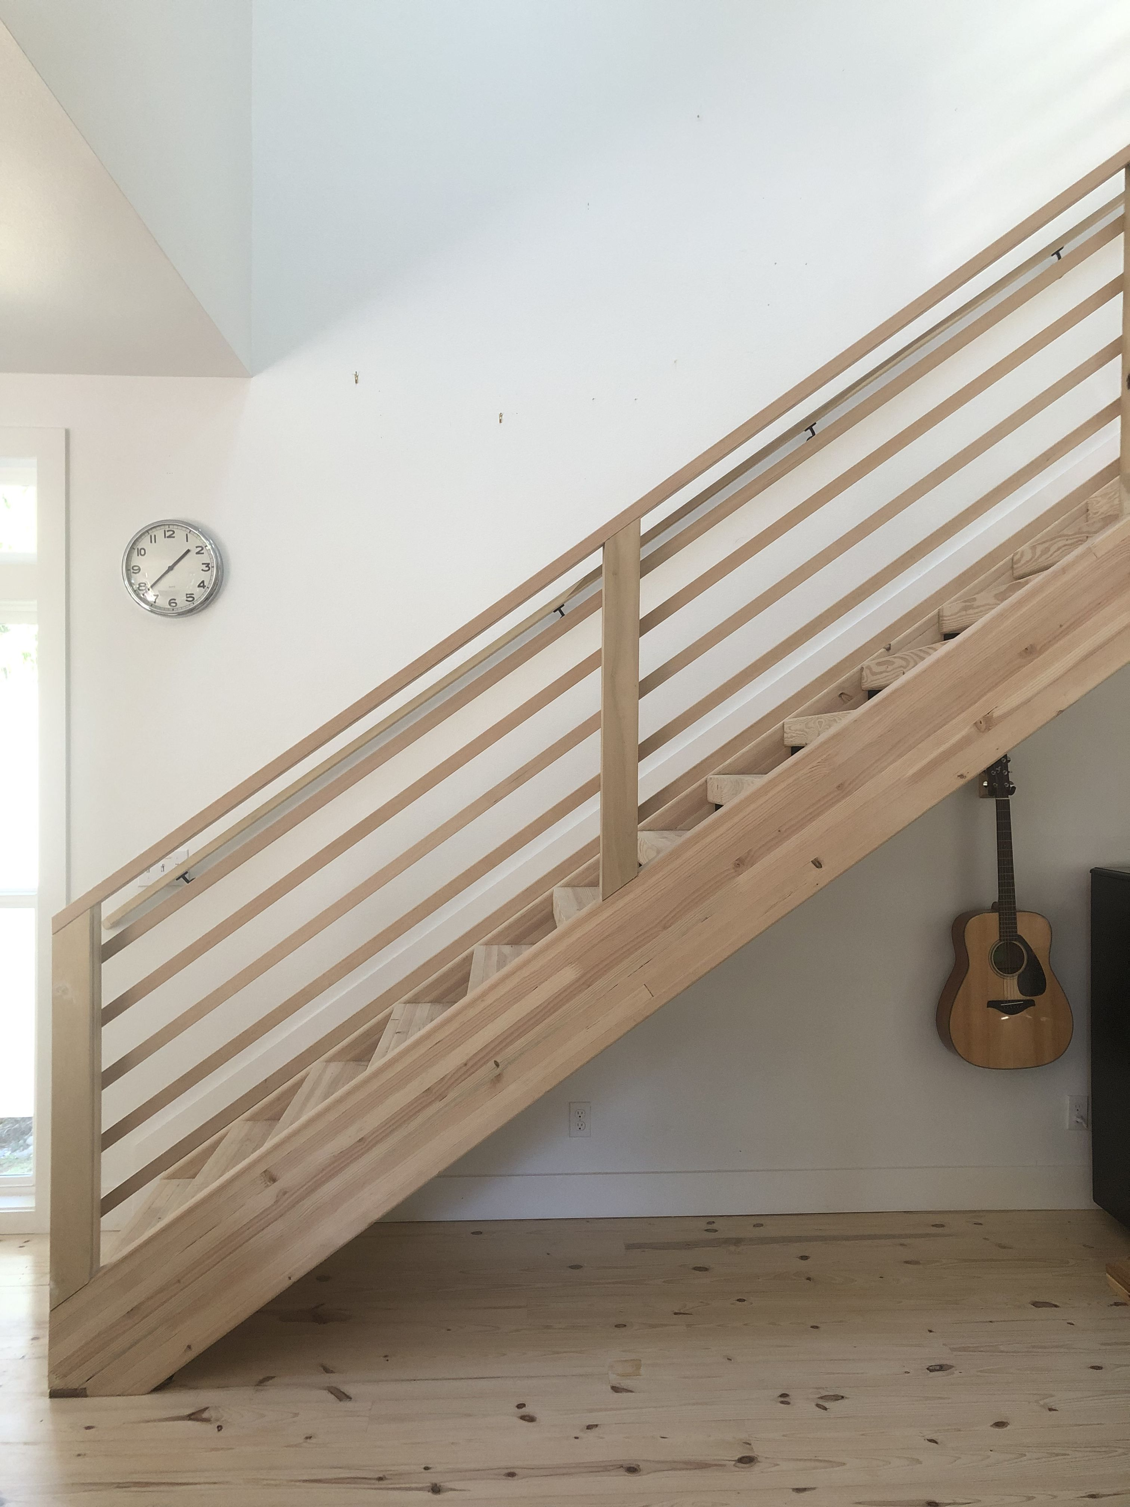

Lines can be
Horizontal
Diagonal
Vertical

Slide 5
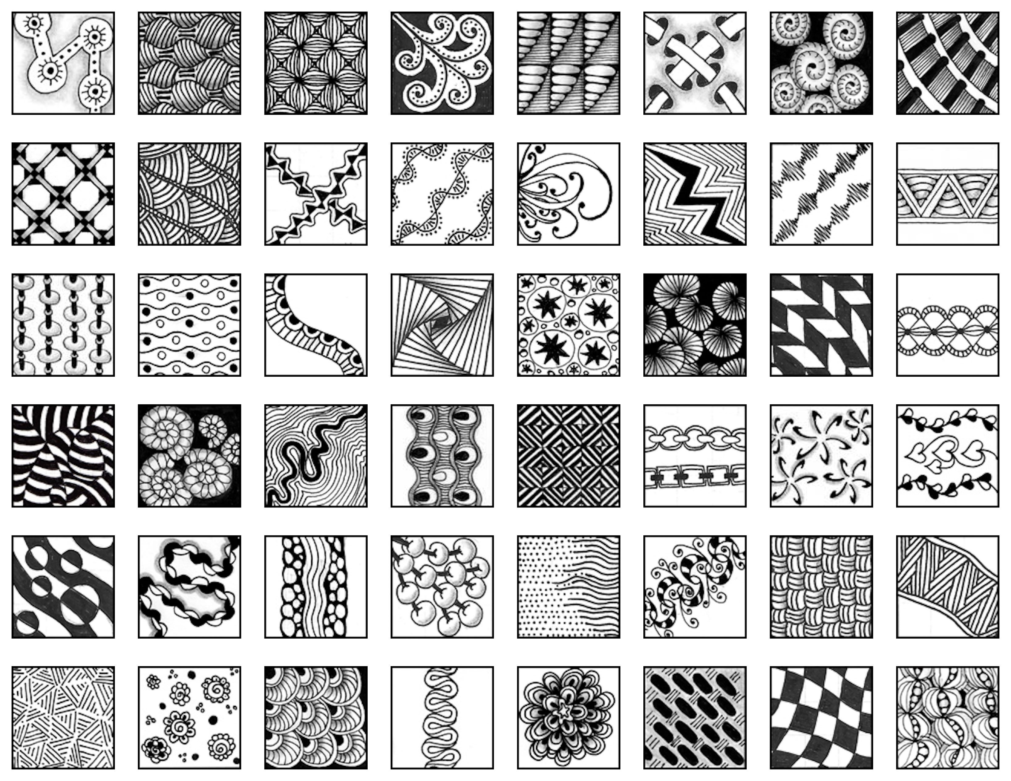

Slide 6
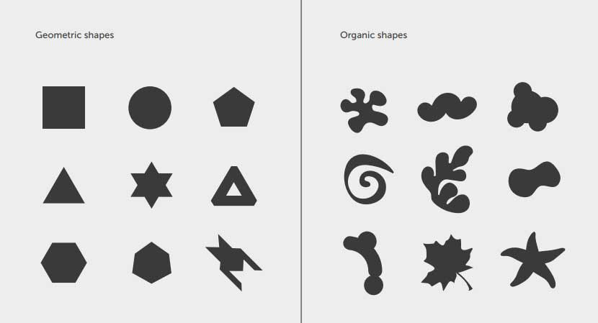
shape
The element characterized by enclosed line, creating both height and width (but not depth)
g the distance between two points.

Slide 7
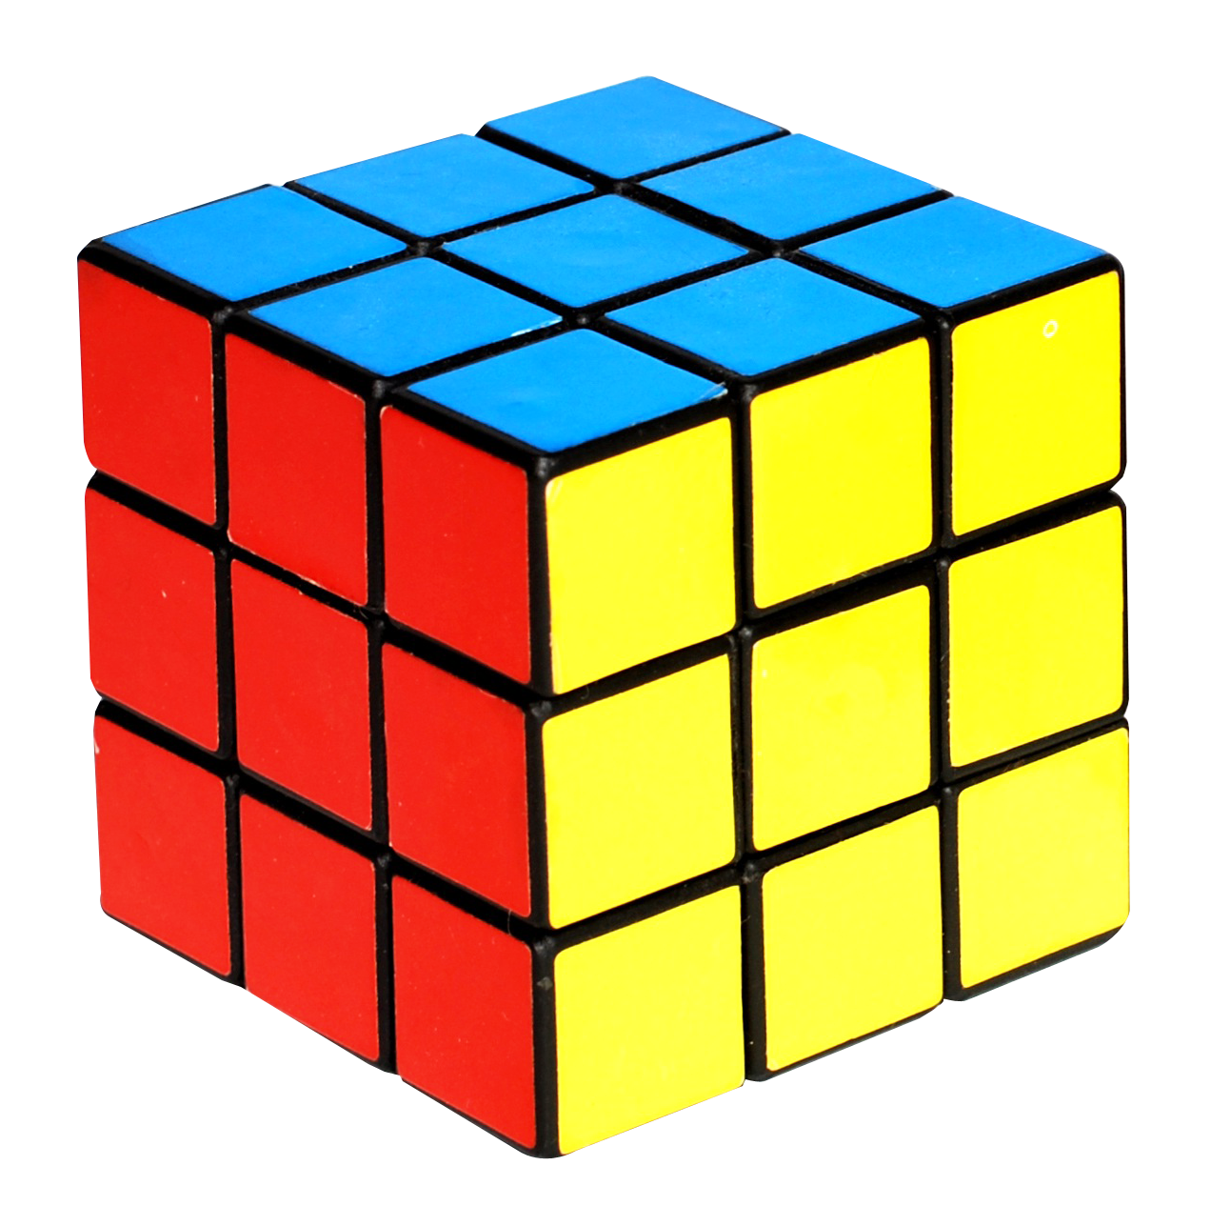
form
Form is a three dimensional object which encloses volume. It has height, width, and depth.

Slide 8
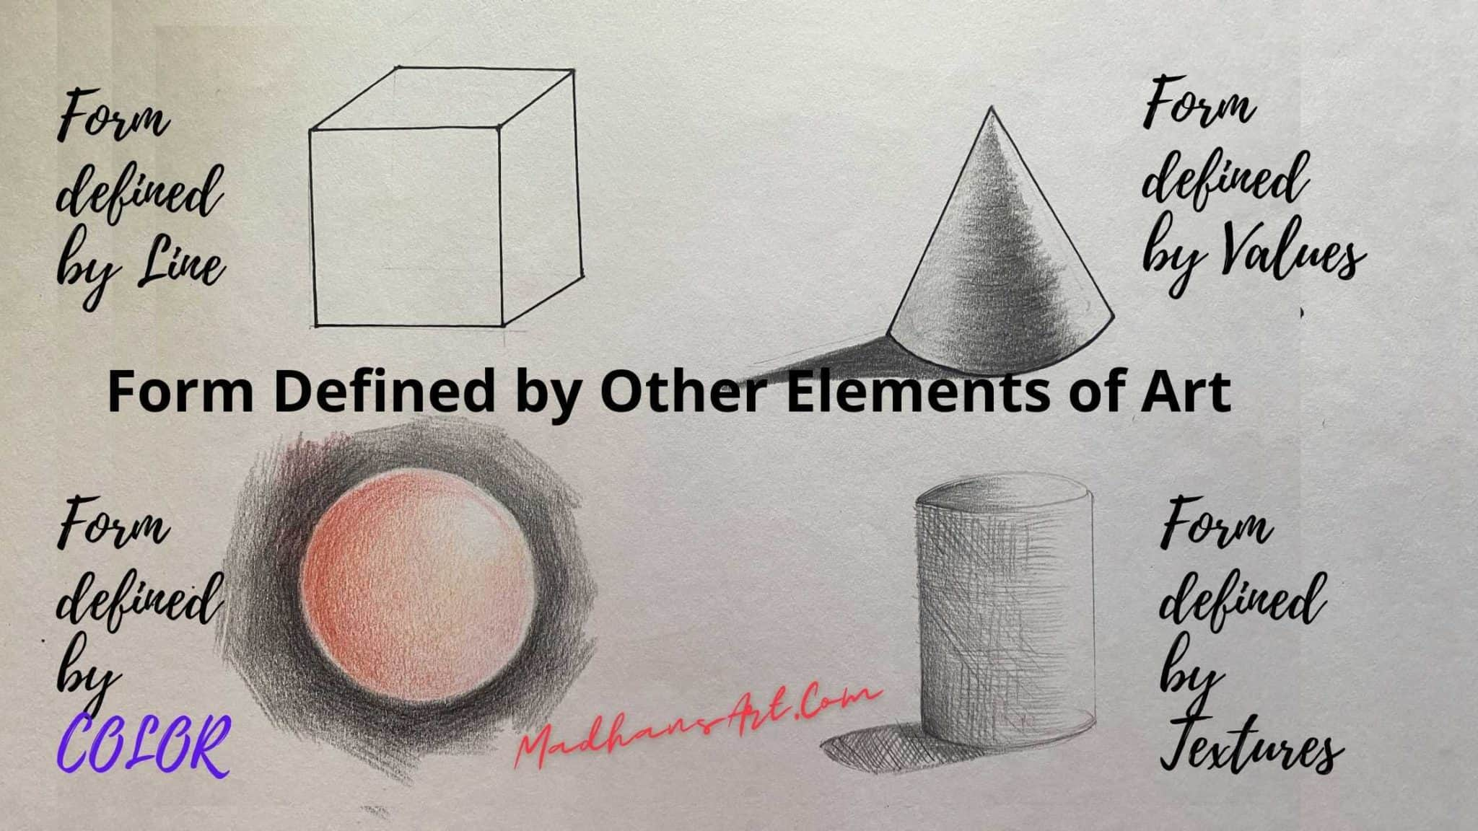

Slide 9
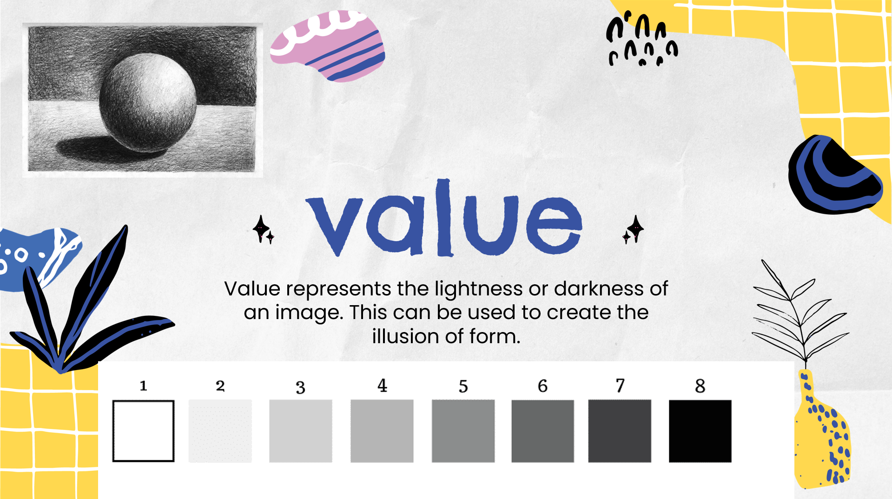
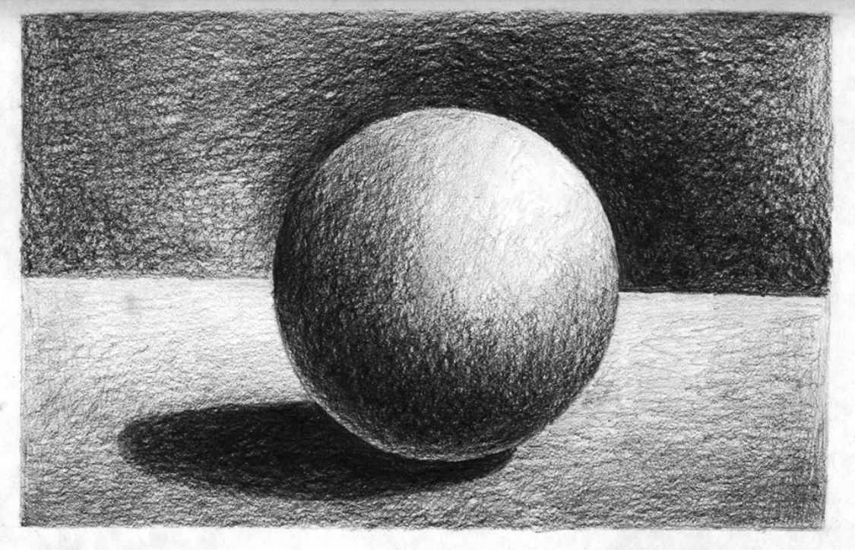
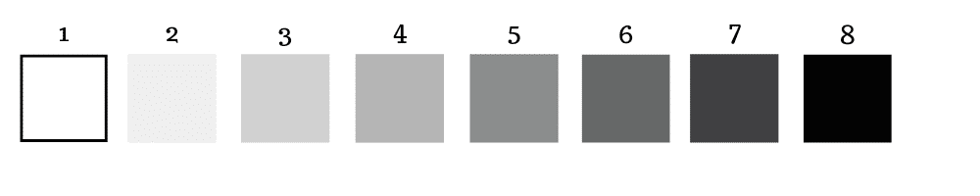
value
Value represents the lightness or darkness of an image. This can be used to create the illusion of form.

Slide 11
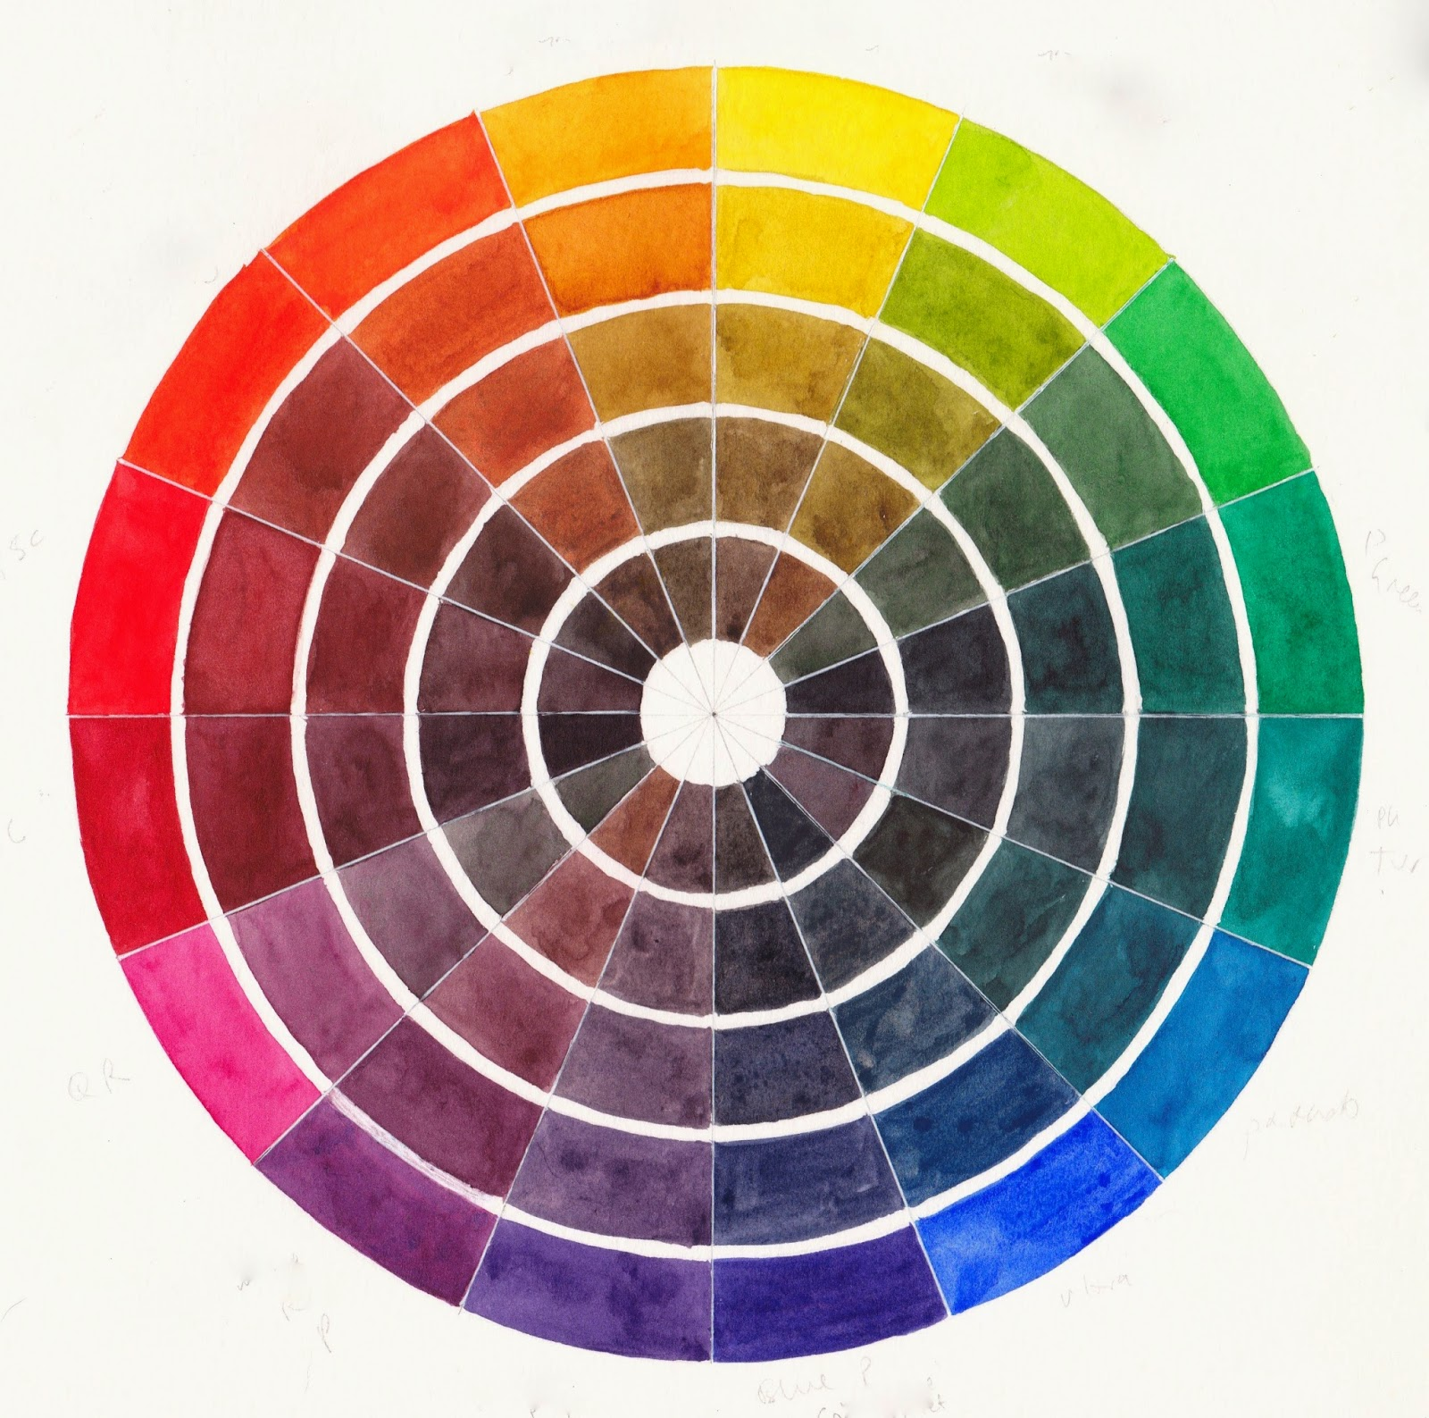

color
Element characterized by hue, saturation, and luminosity.

Slide 12



Hue saturation luminosity

Slide 13
Primary Colors (Kind of)
Red
Blue
Yellow
The three colors can be mixed together in different combinations to make any color.

Slide 14
Secondary Colors
Orange
Purple
Green
These colors are made by mixing primary colors.
1.) Red and yellow make orange
2.) Red and blue make purple
3.) Yellow and blue make green

Slide 15
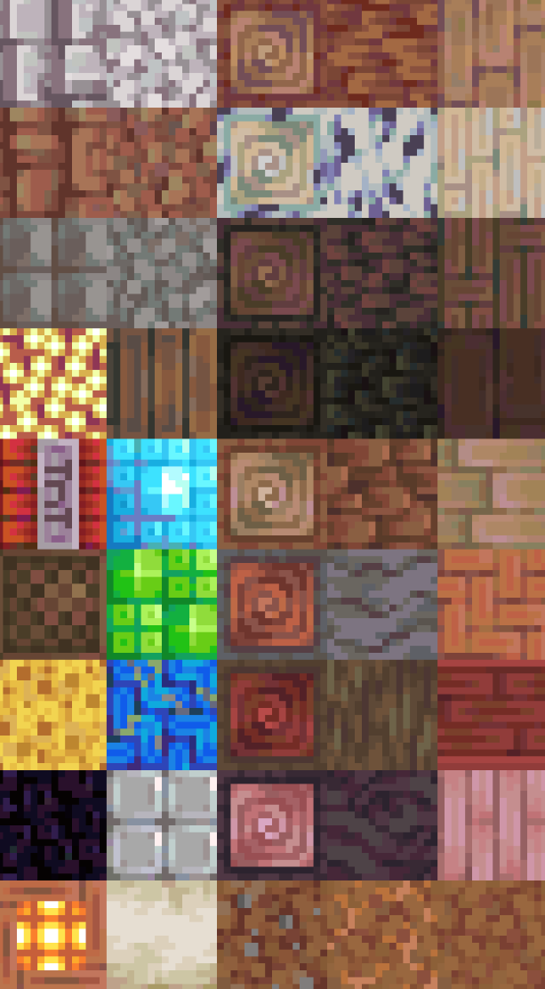
texture
The element of art referring to the visual or physical surface quality of a piece.

Slide 16
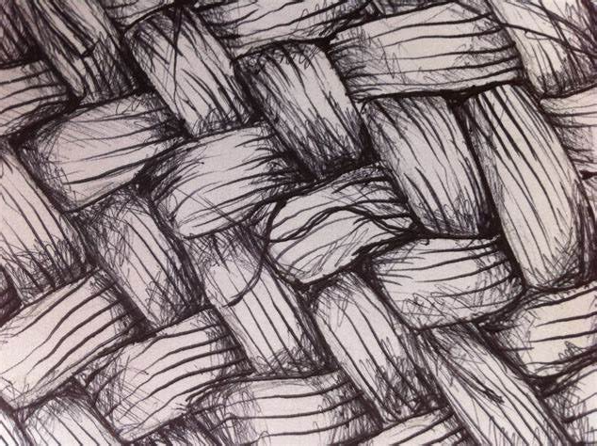
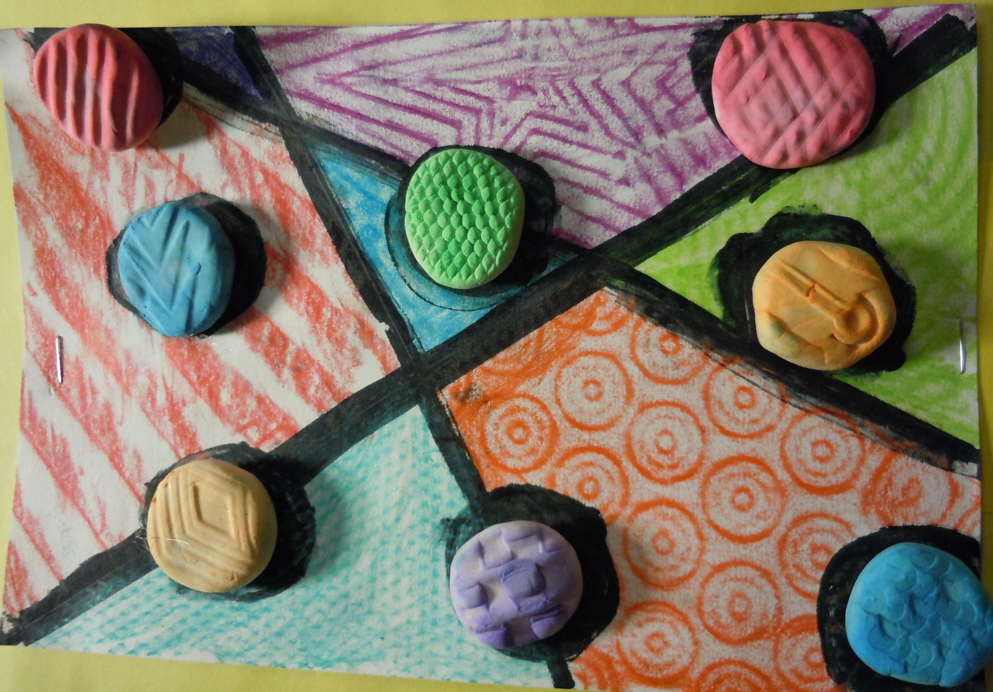
What is texture in art?
Tactile Texture:
Actual
How it feels
Can be felt
Visual Texture:
Implied
How it looks
Can’t be felt

Slide 17
space
Space in art is the element that creates a sense of depth, dimension, and distance on a flat surface

Slide 18
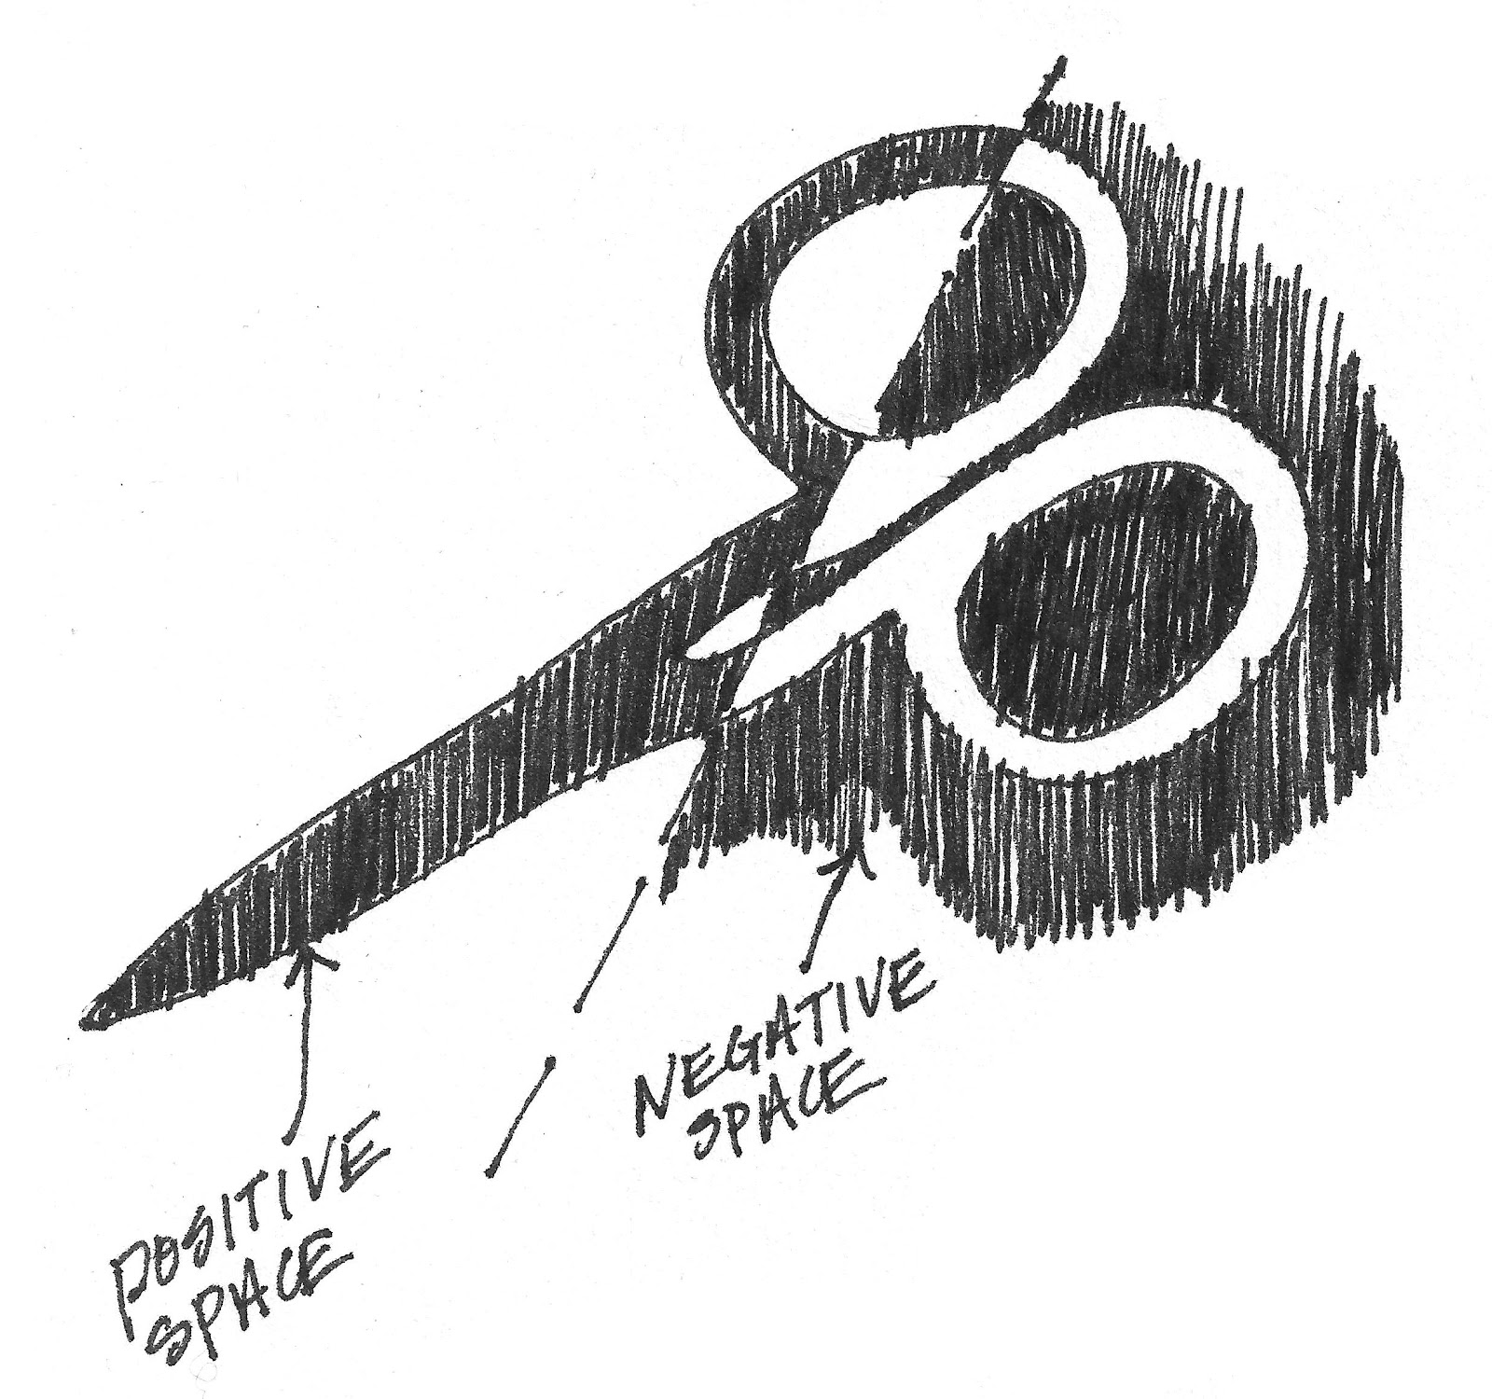

Positive vs Negative Space

Slide 19
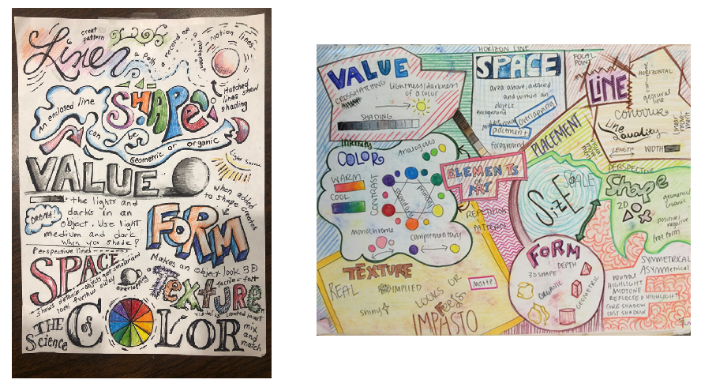
Elements of Art Sketchbook

