Slide 1
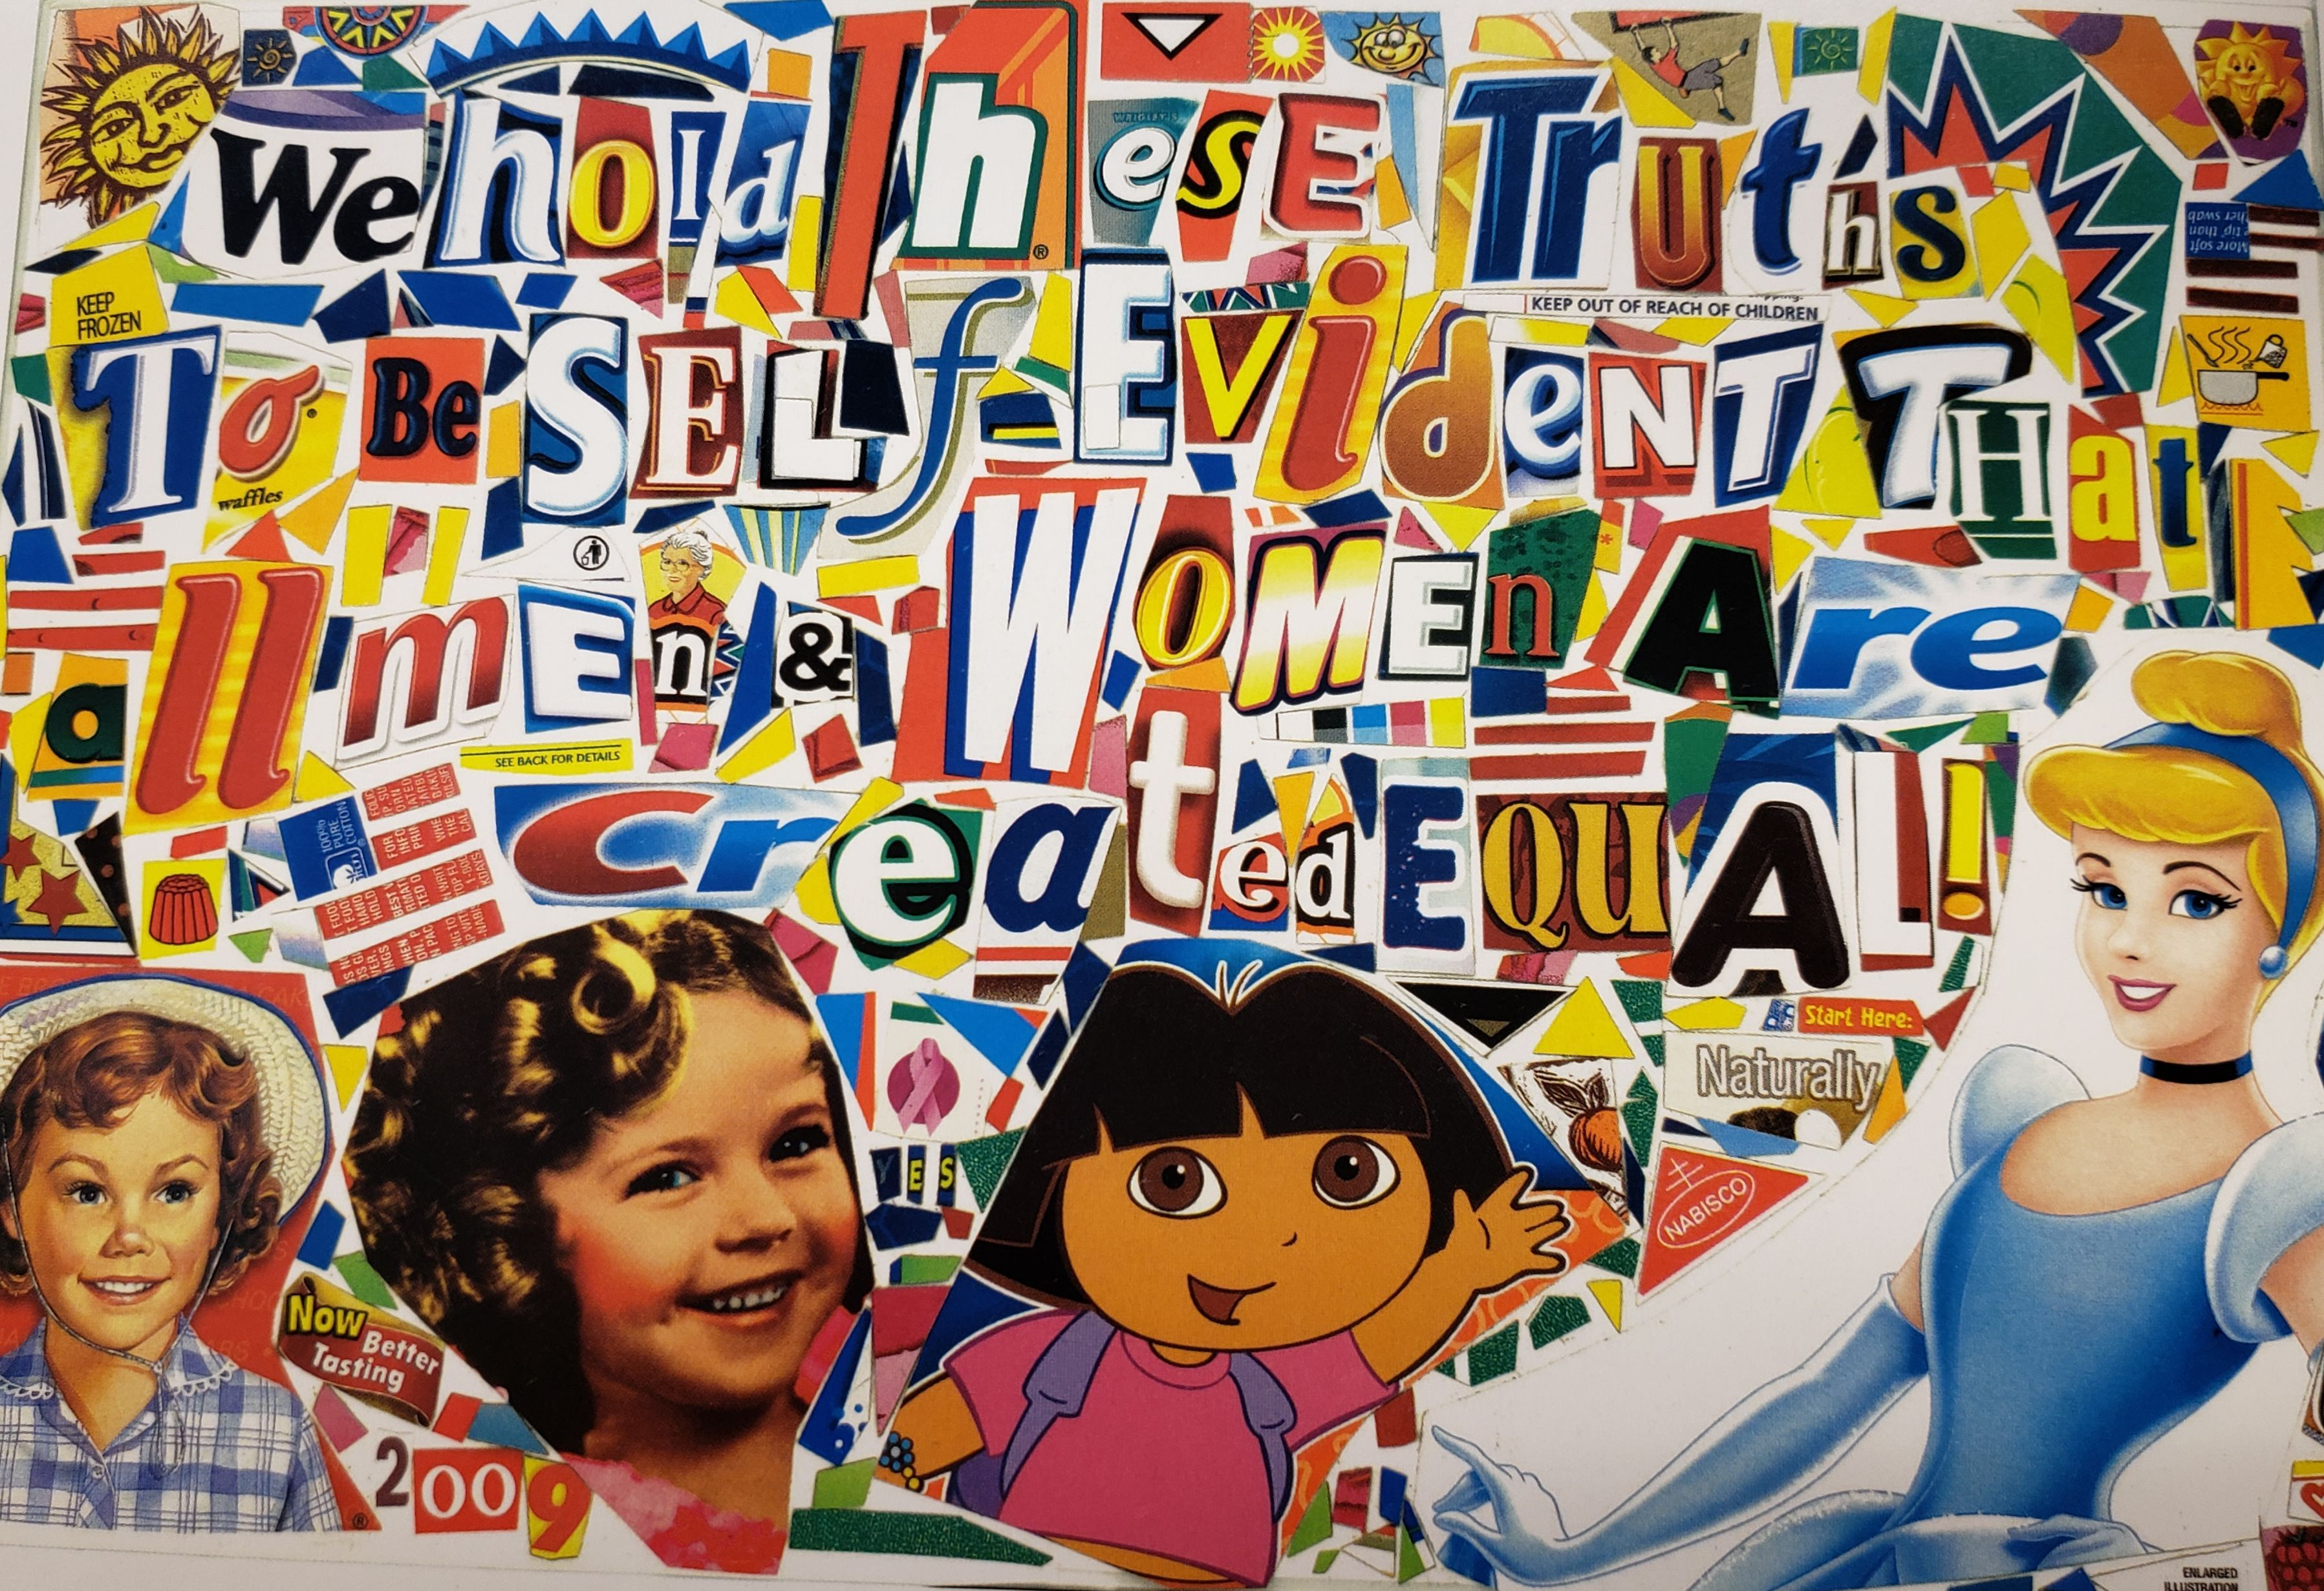
WHERE DO I BELONG?

Slide 2
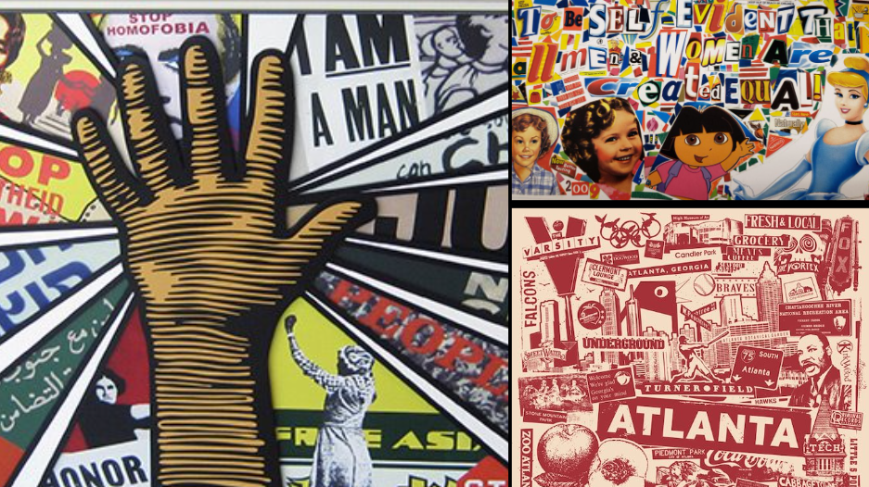
What is a collage?

Slide 3
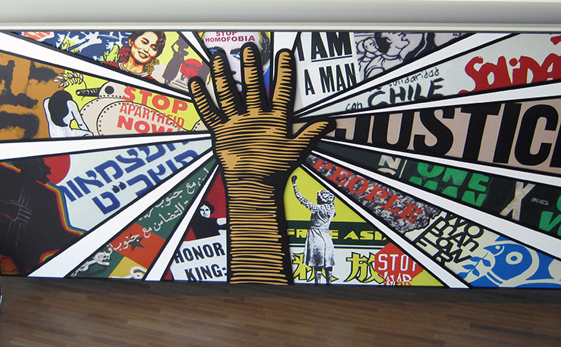
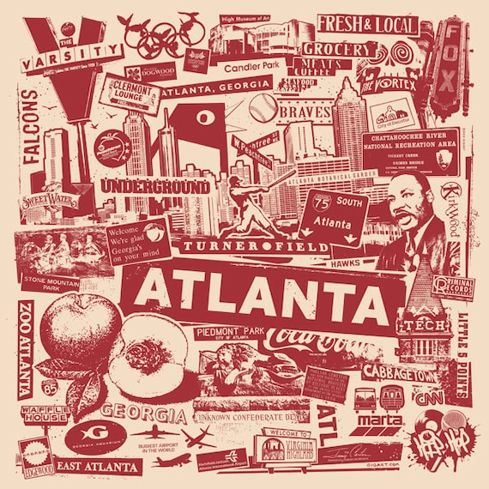
What is a collage?
A collage is like making a picture using different things like magazine clippings, fabric, or photos.
You cut or tear these materials and stick them onto a surface, like paper or a canvas.
When you put everything together, it forms a new and unique image or design.

Slide 4
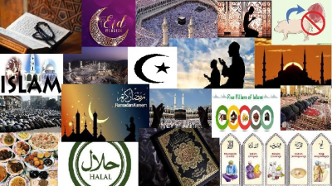
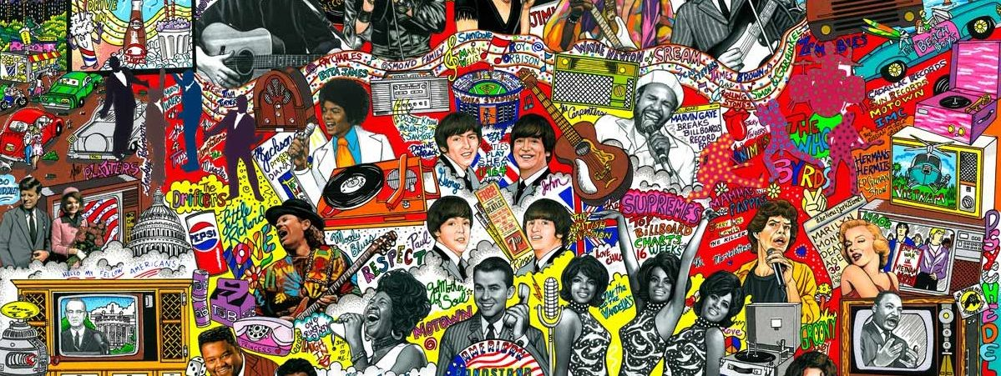
What makes a collage good?

Slide 6
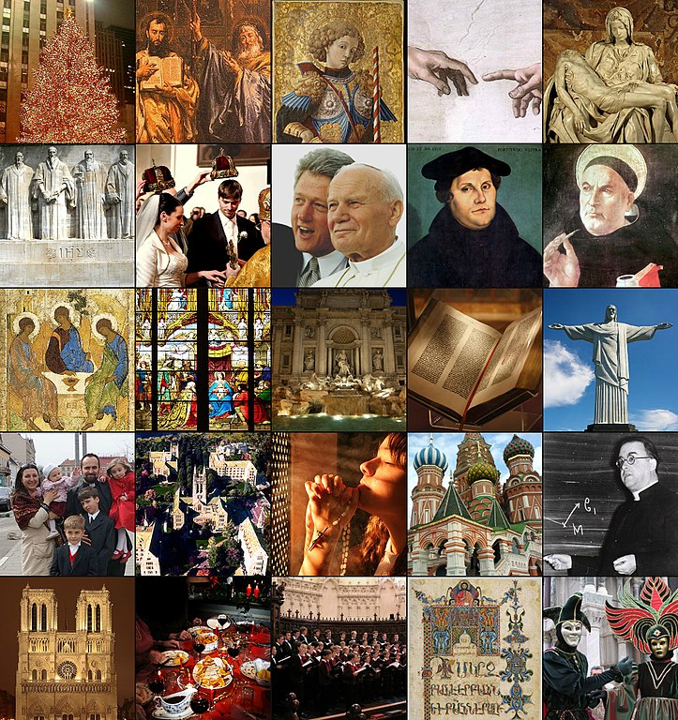
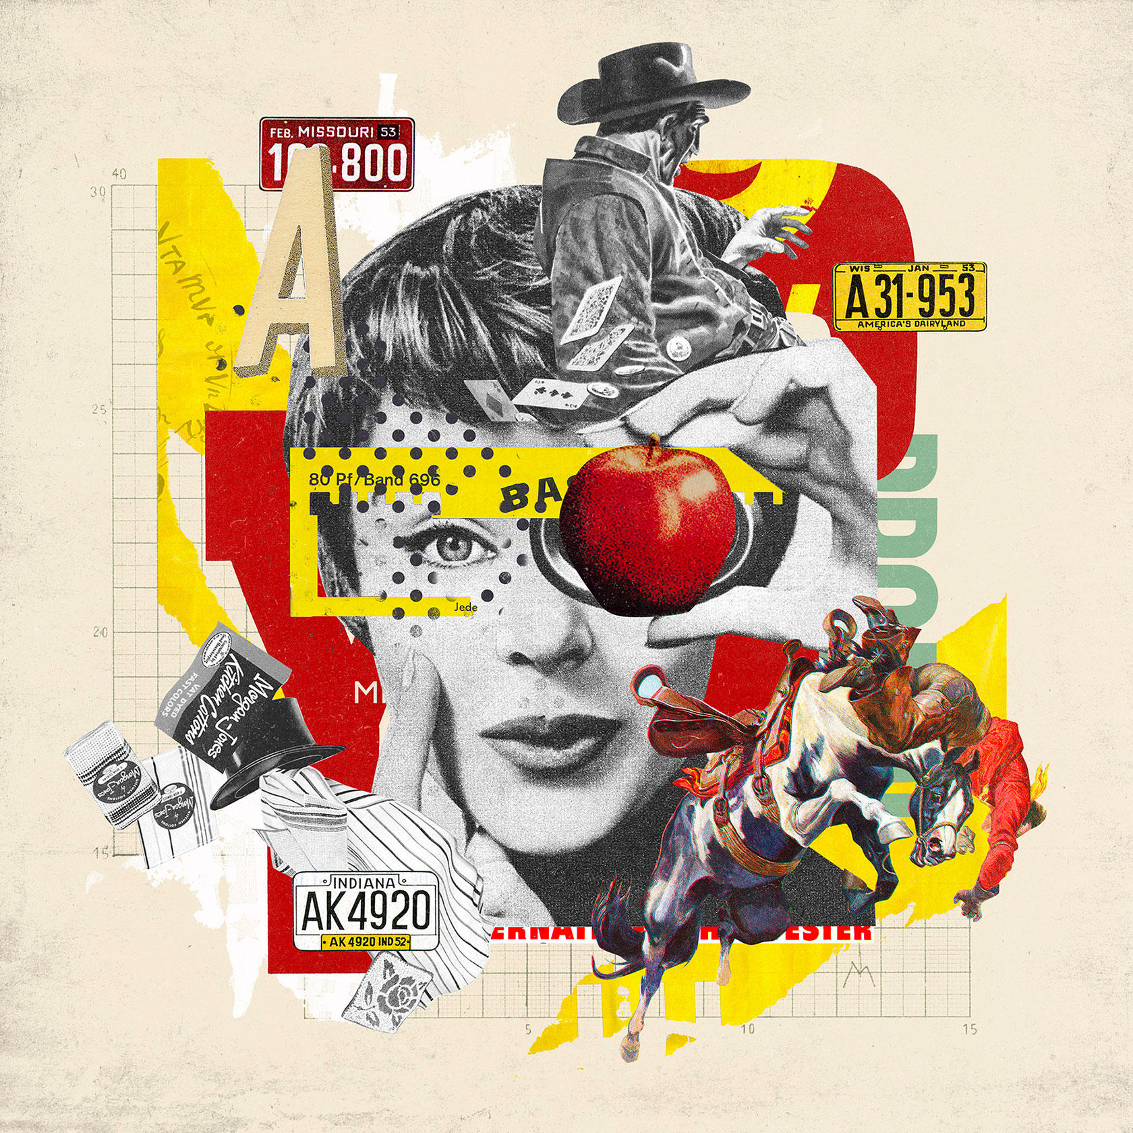

Slide 7
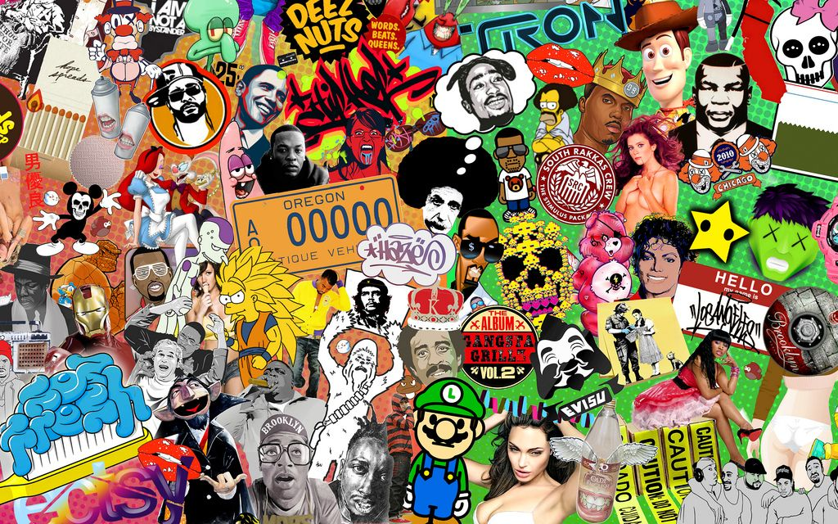
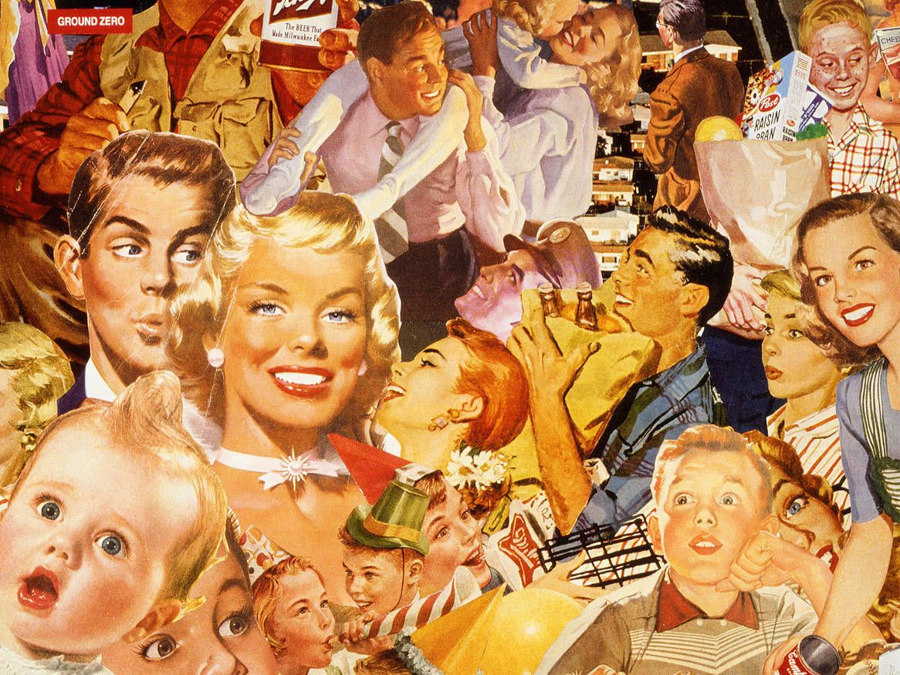
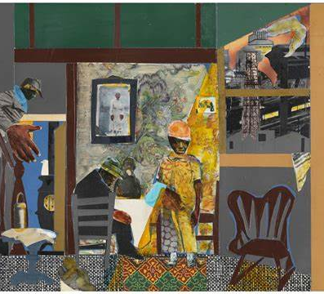
Role of cultural expression through art…
Cultural art is essential for preserving heritage, fostering creativity and innovation, promoting diversity and understanding, and enriching the human experience. It is a powerful tool for social change, empowerment, and collective expression.
Cultural art also creates a sense of identity that unifies and builds a community, while sharing an individual’s perspective.

Slide 8
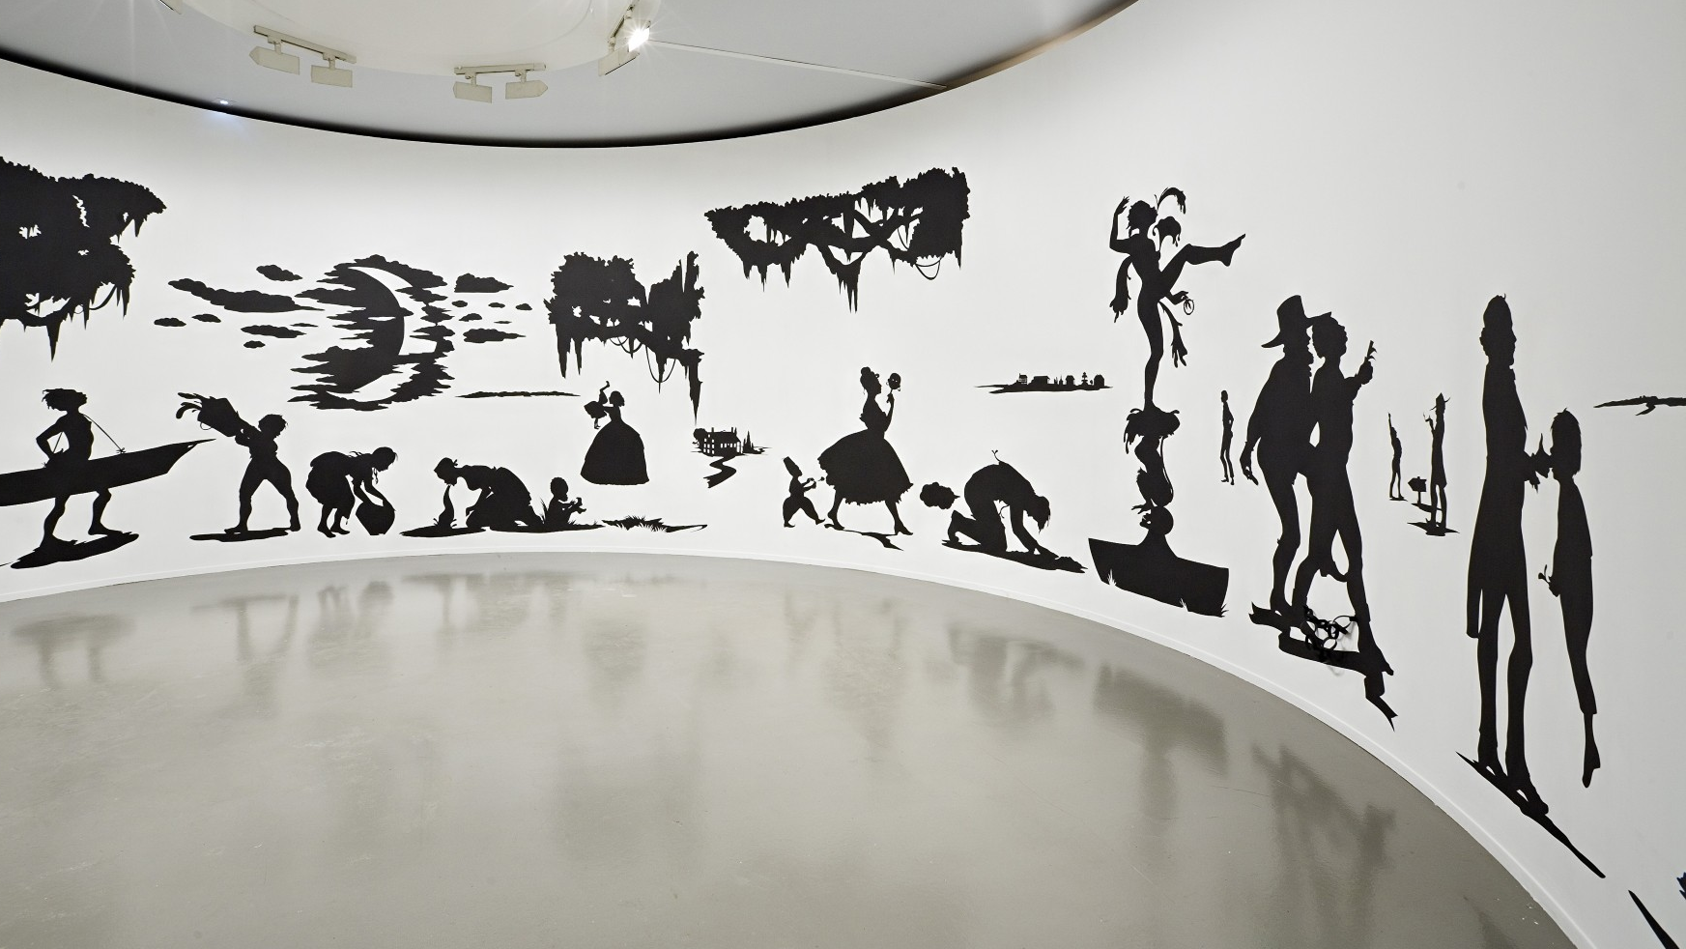
Visualizing culture
Traditional Symbols/Iconography
Cultural Landscapes
Cultural Practices/Rituals/Religions
Political and Social Commentary
Activities/Entertainment or Pop Culture
Holidays

Slide 9
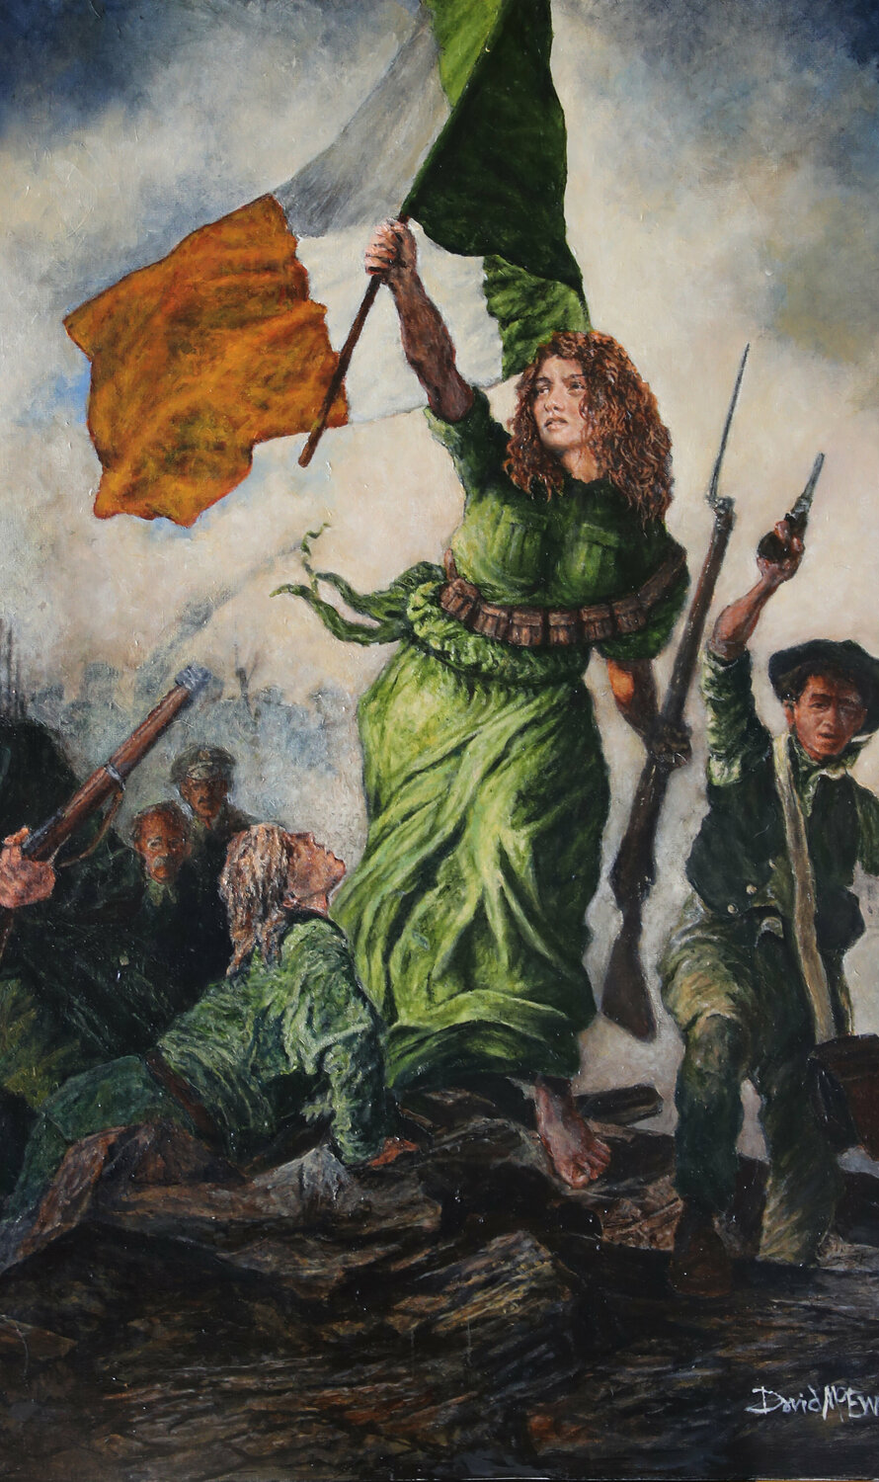
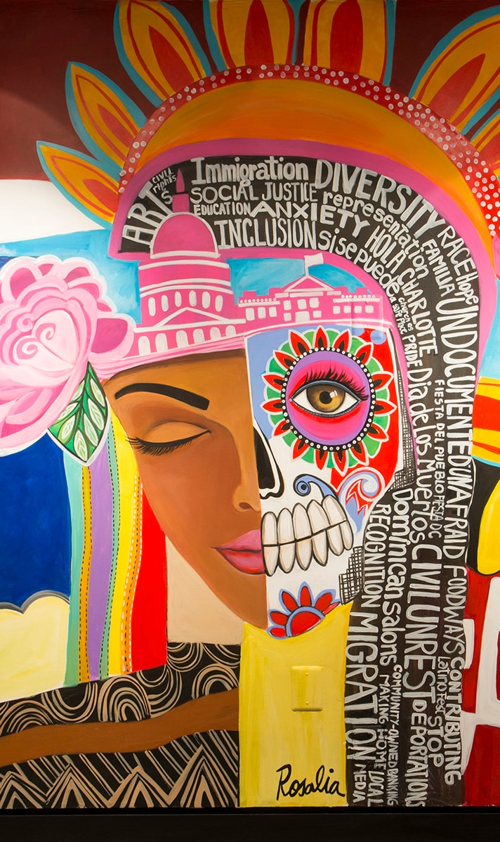
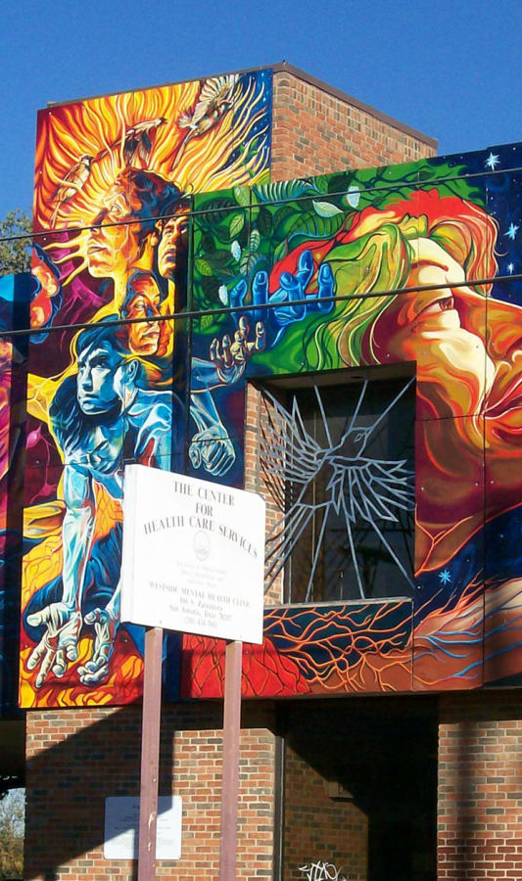
Visualizing cultural art

Slide 10
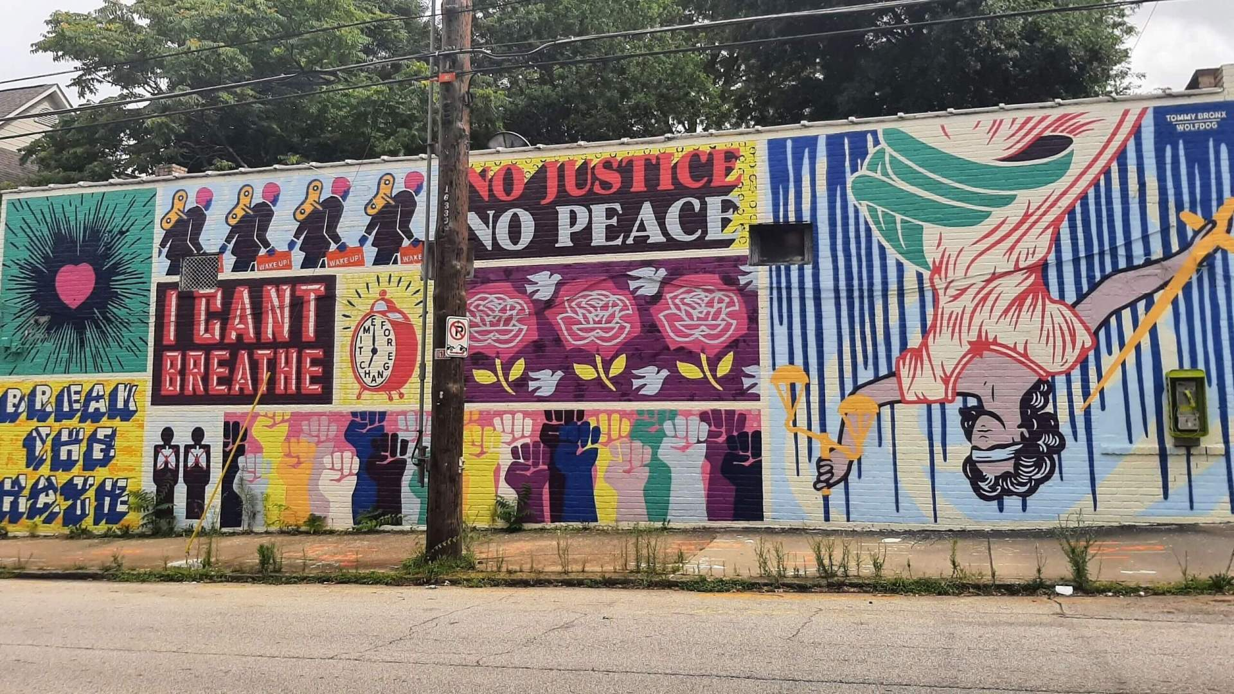
Social commentary

Slide 11
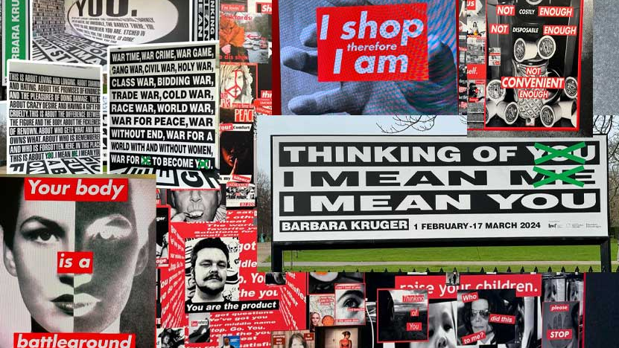

Slide 12
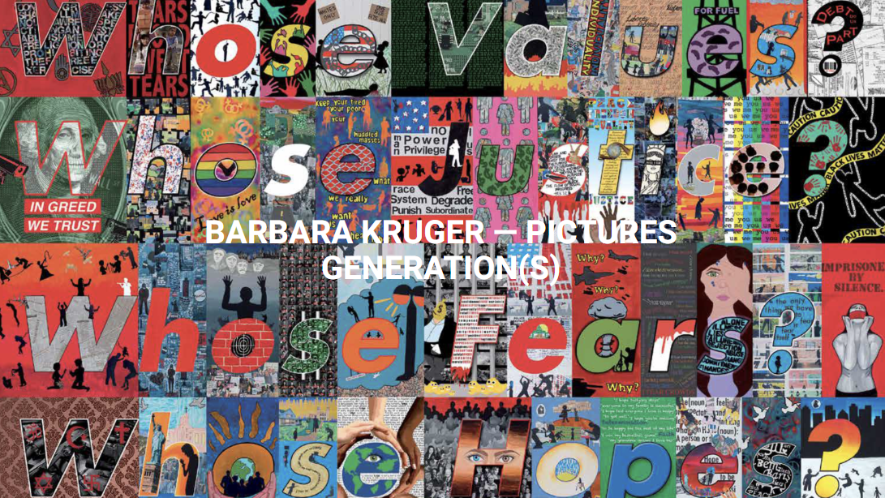

Slide 13

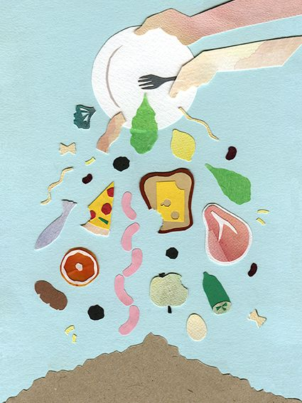
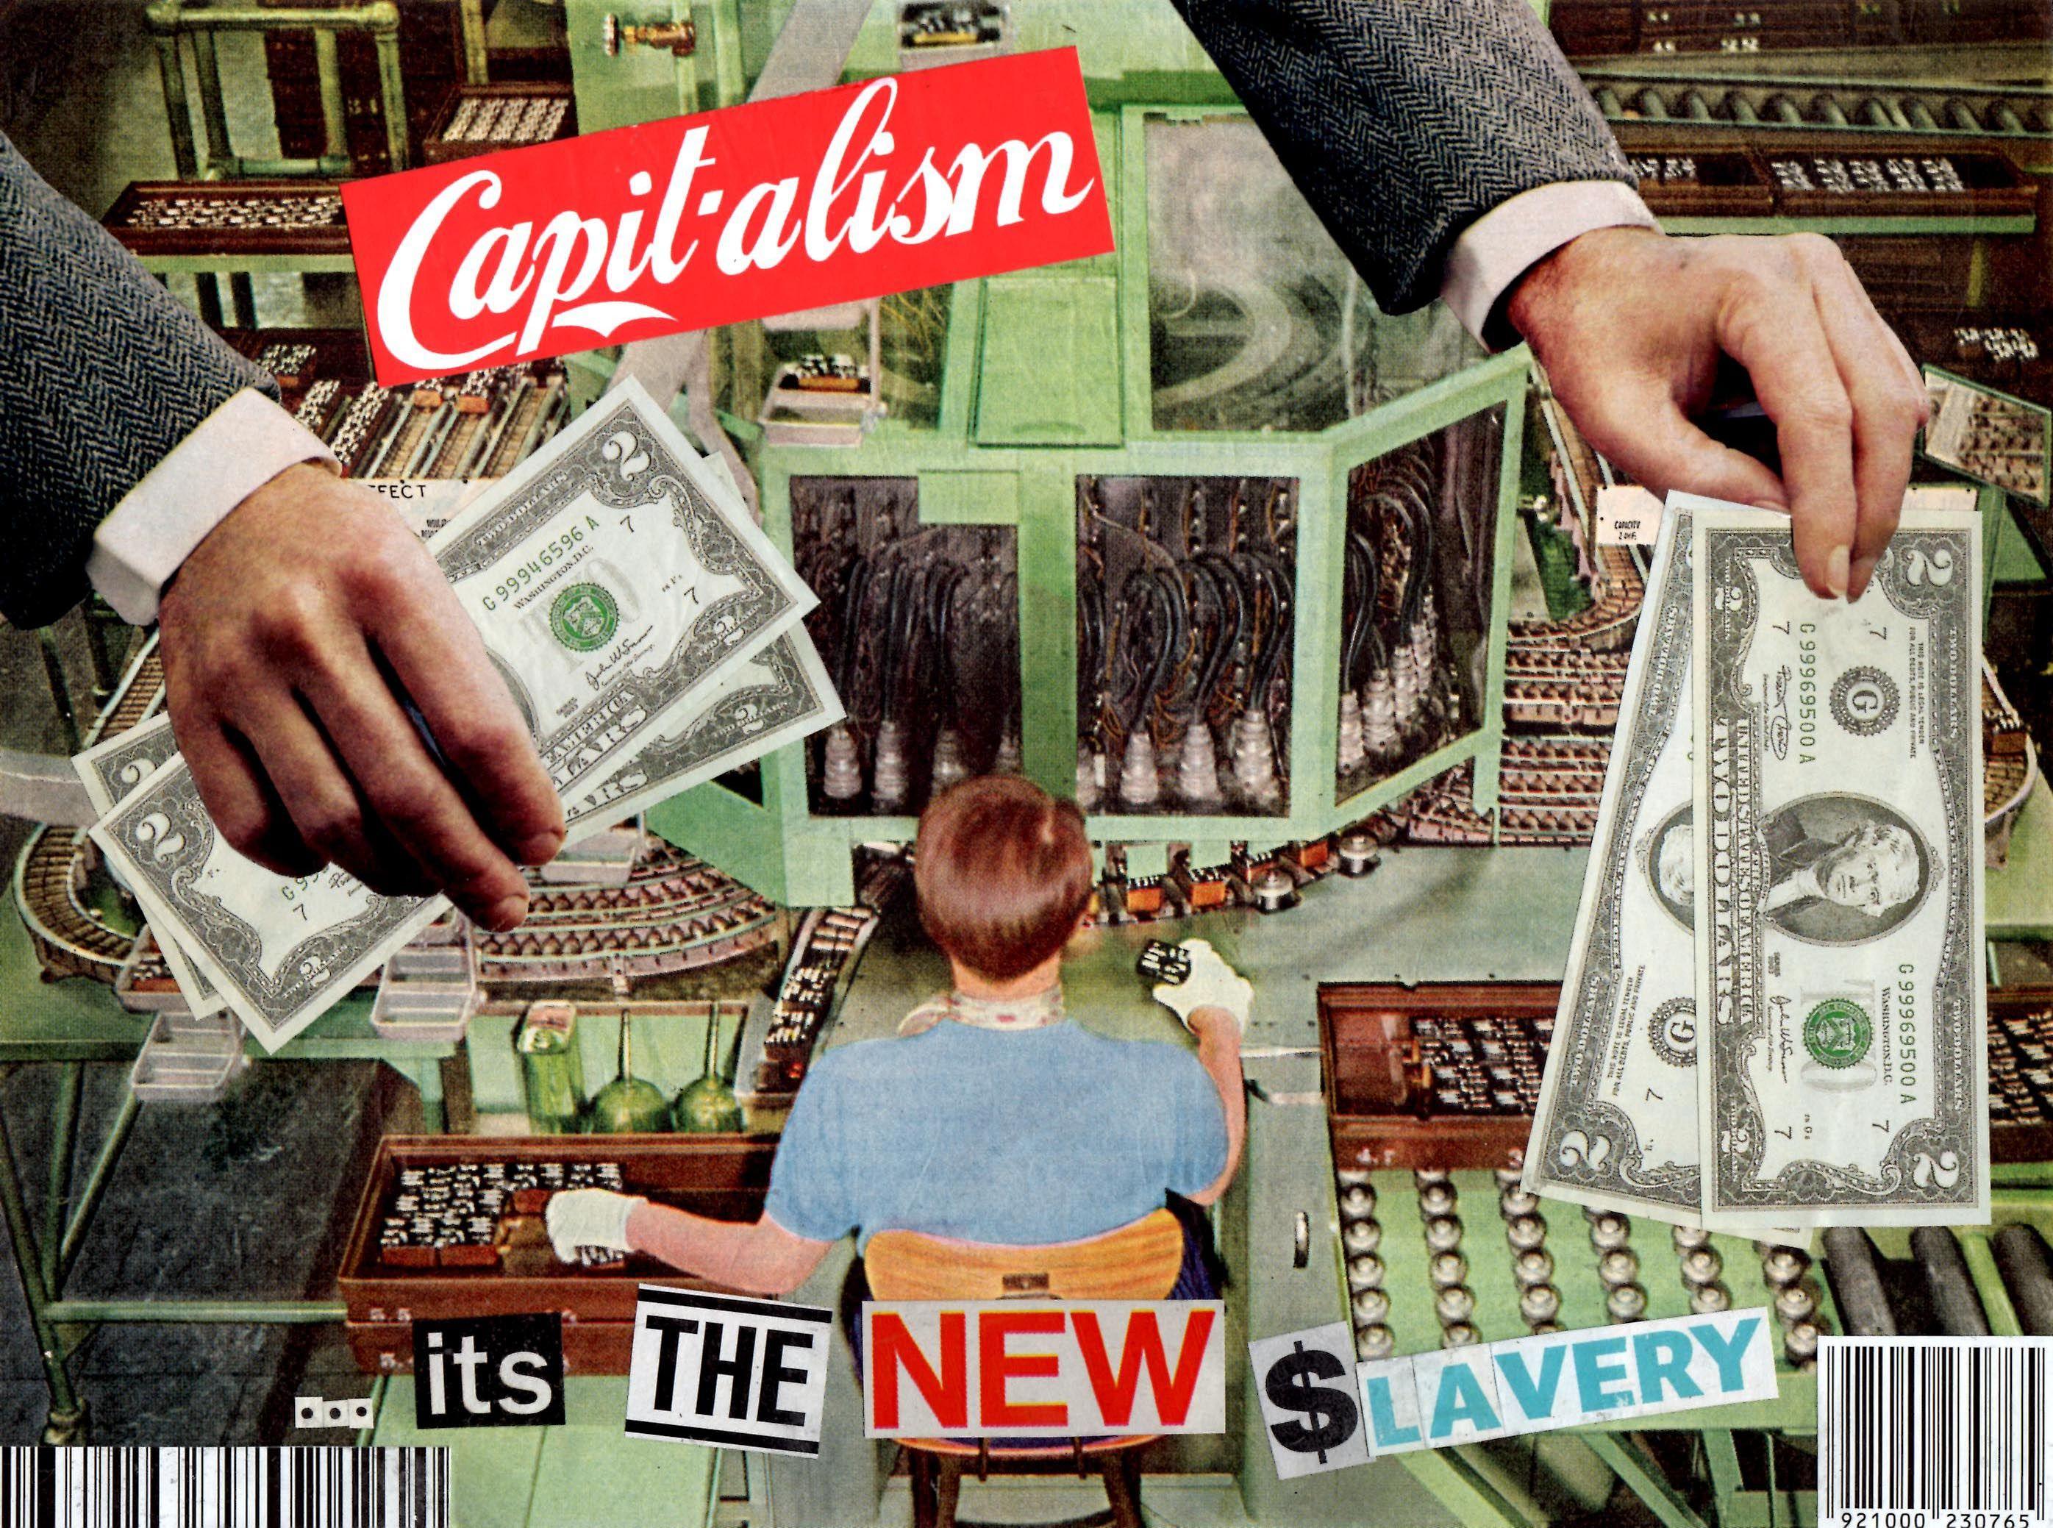

Slide 14
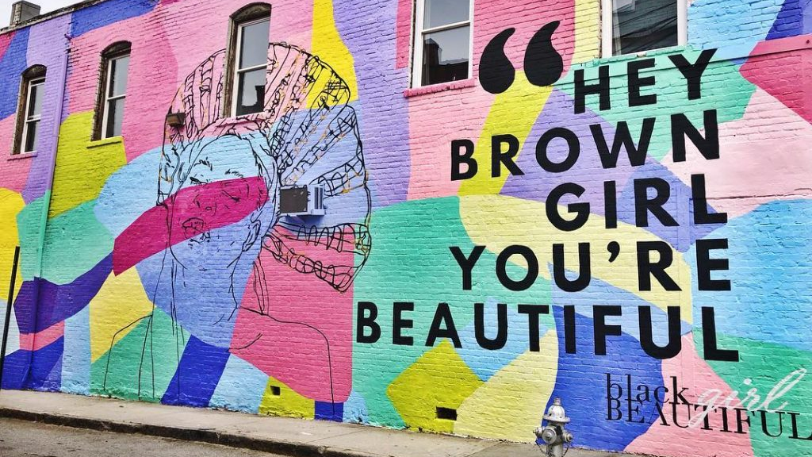

Slide 15
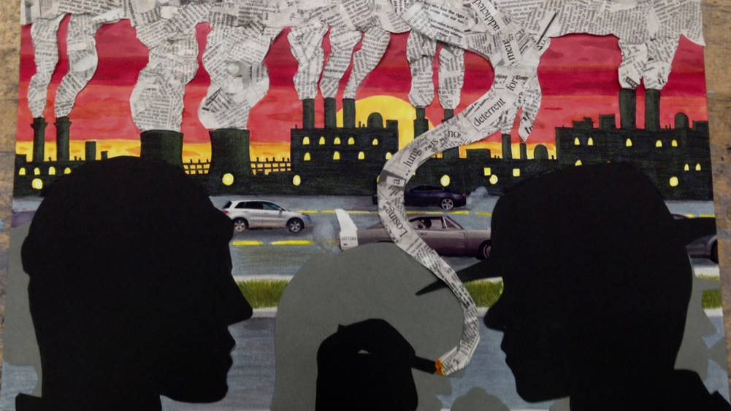

Slide 16
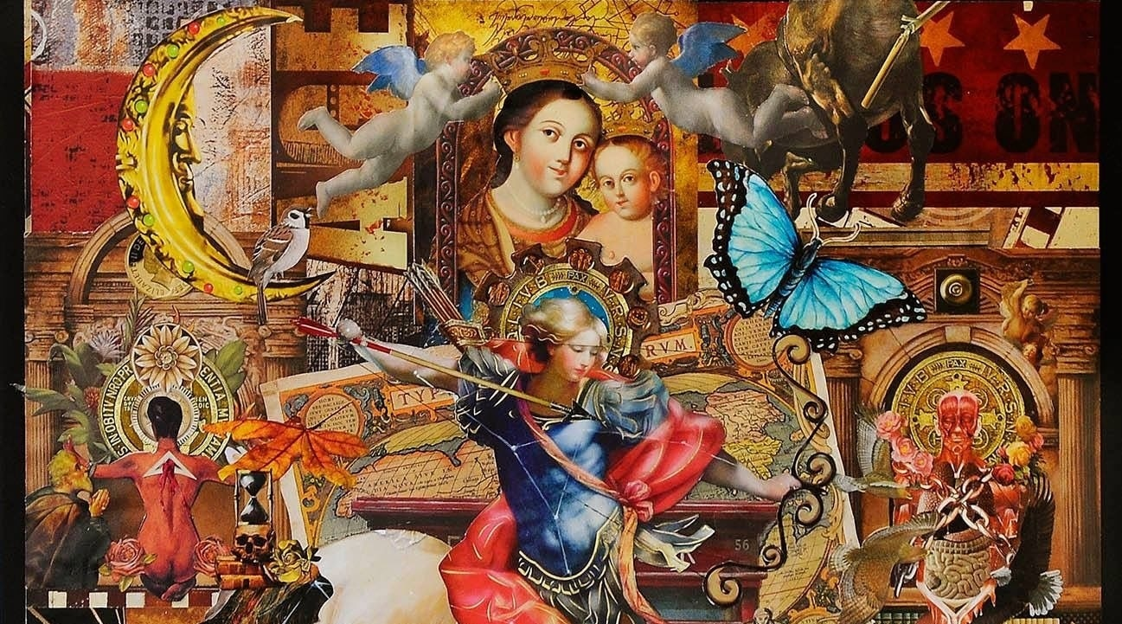
religion

Slide 17
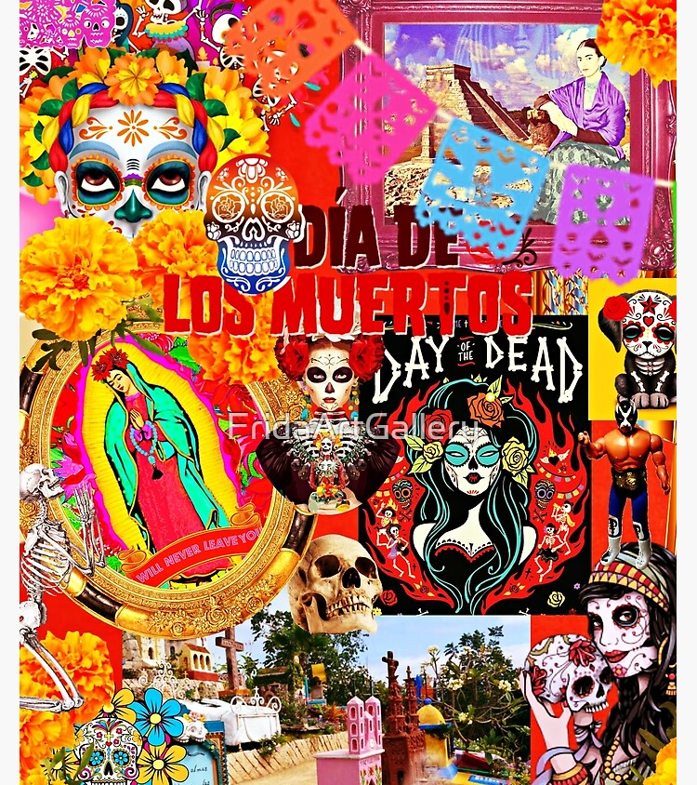
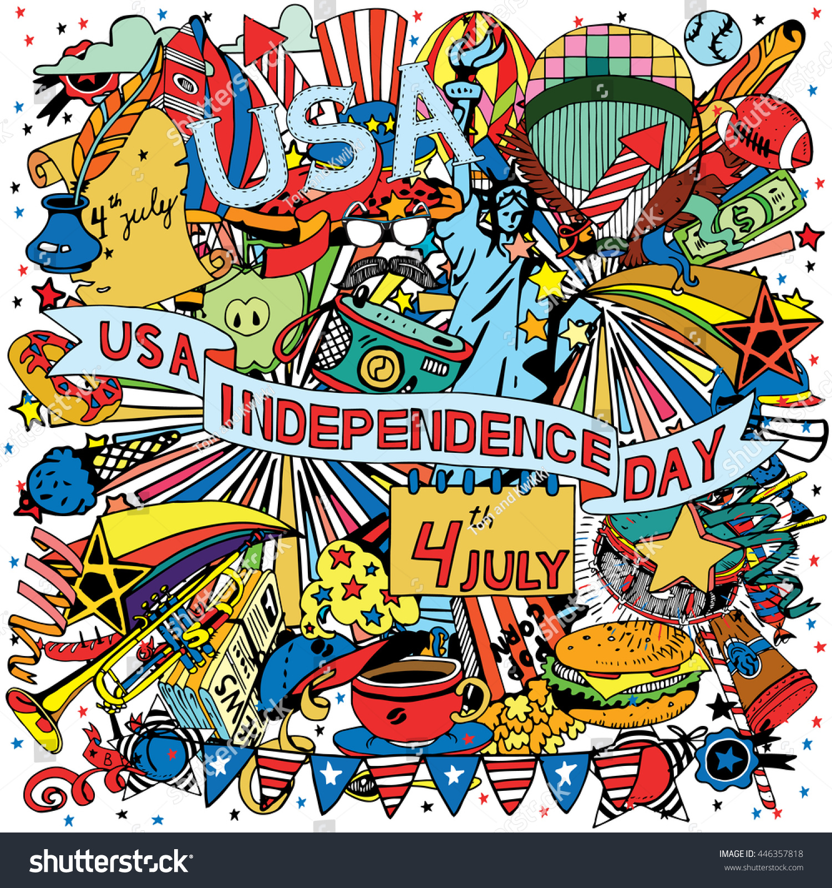
Holidays

Slide 18
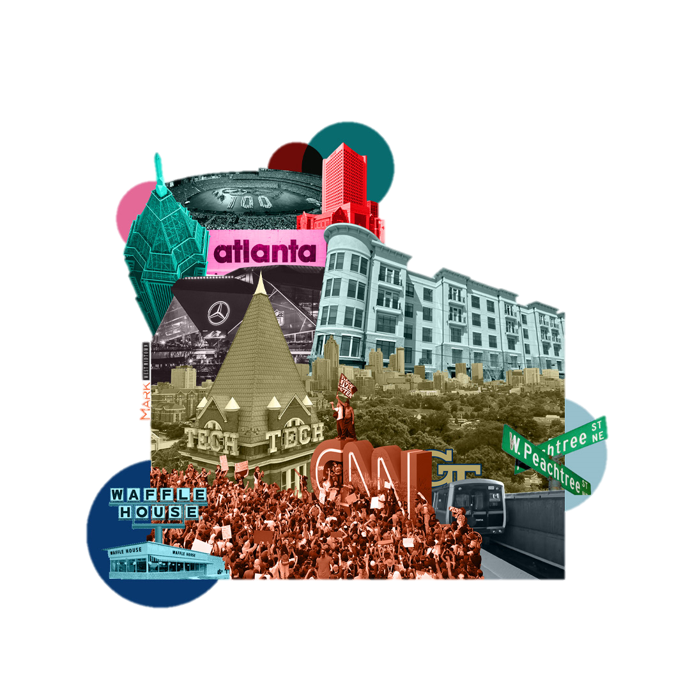
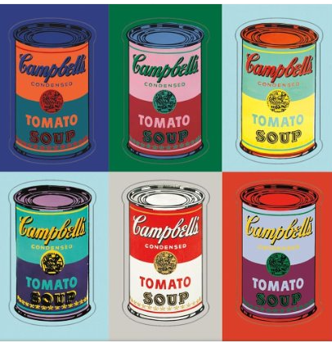
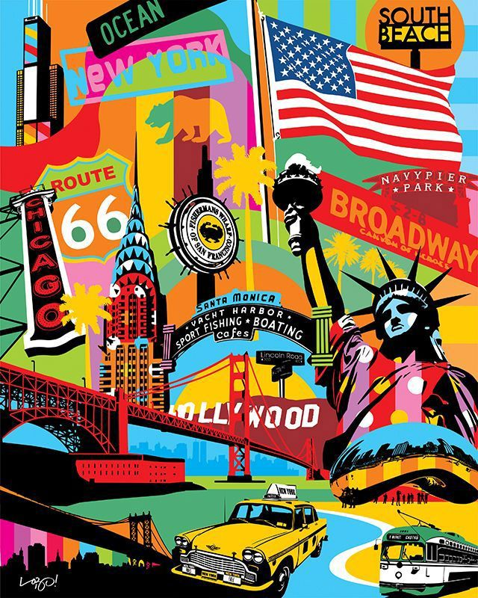
Activities/entertainment/pop culture

Slide 19
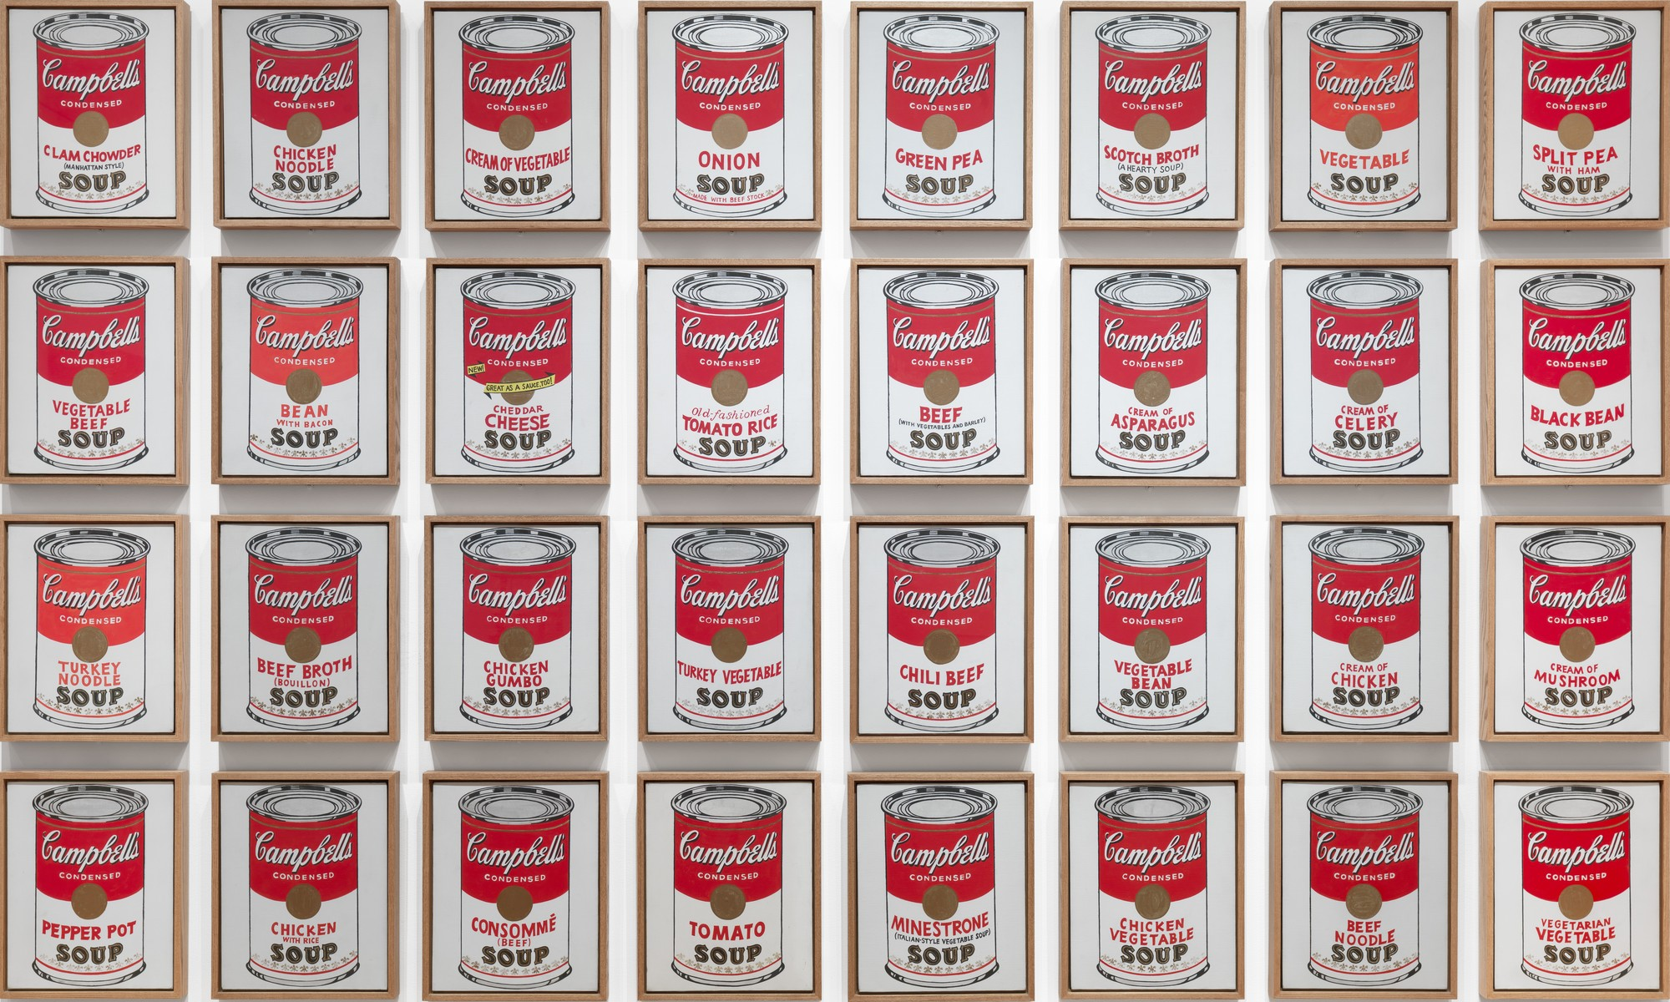

Slide 21
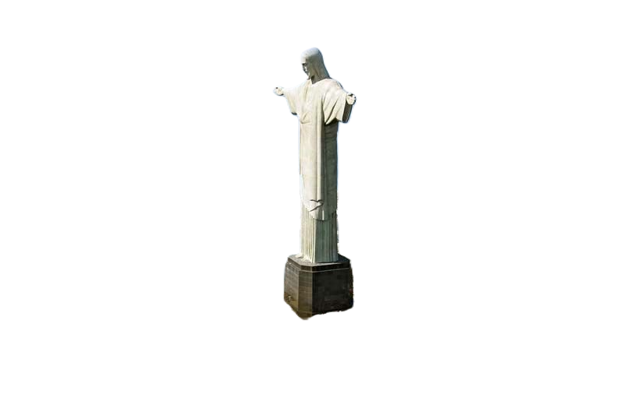

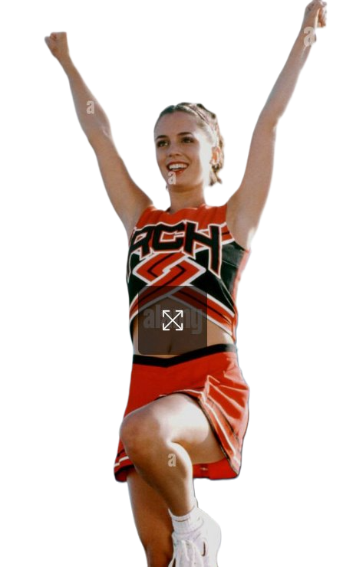
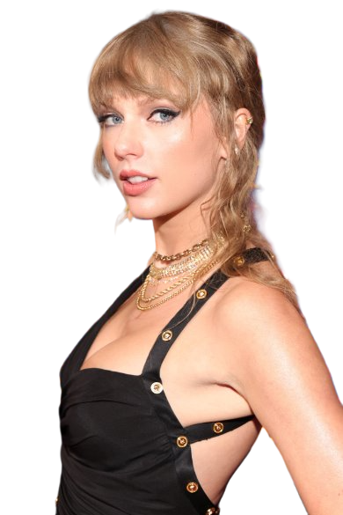
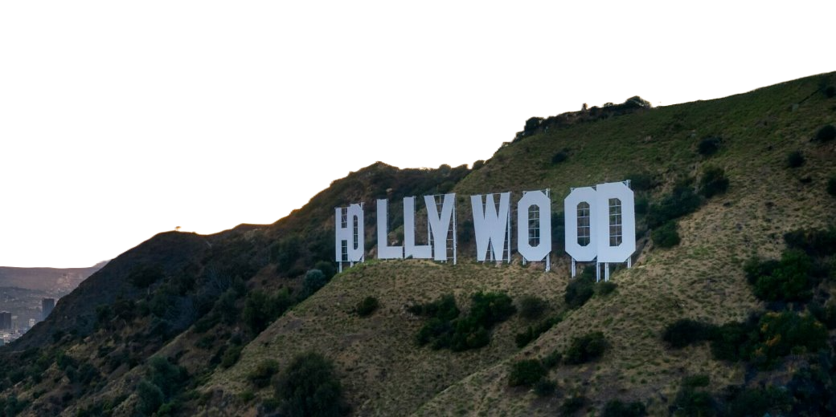

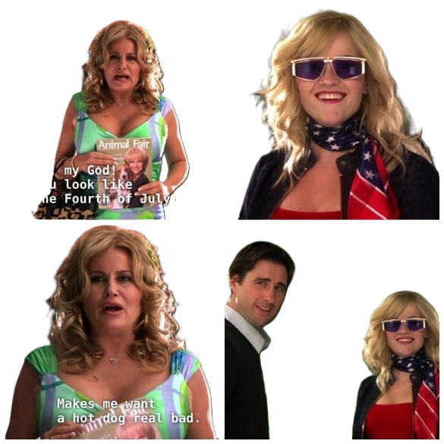
IN YOUR SKETCHBOOK...
In your sketchbook you will give examples of YOUR personal cultural identity. For example...
Symbols/Logos -
Hobbies/Cultural Practices
Religions -
Pop culture -
Cultural landscapes
- Holidays

Slide 22
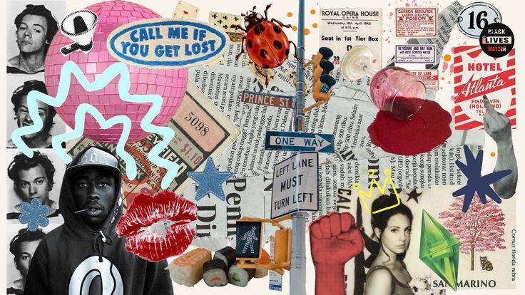
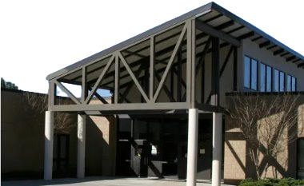
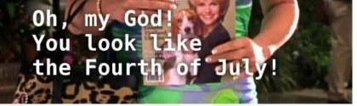

Slide 23
Directions: In your sketchbook, give examples PERSONAL to you how you could show your culture through:
Symbols/Logos
Cultural Landscapes
Cultural Practices/Rituals
Religions
Political and Social Commentary
Activities/Entertainment or Pop Culture
Holidays
Language/Memes
Culture: A community’s shared activities, beliefs, values, and social institutions.
Identity: Characteristics unique to us
Perspective: Viewpoint of the world around us.
Collage: An artwork made by cutting and glueing a variety of photographs or pieces of paper to a backing.
Culture + collage
Sketchbook 3

Slide 24
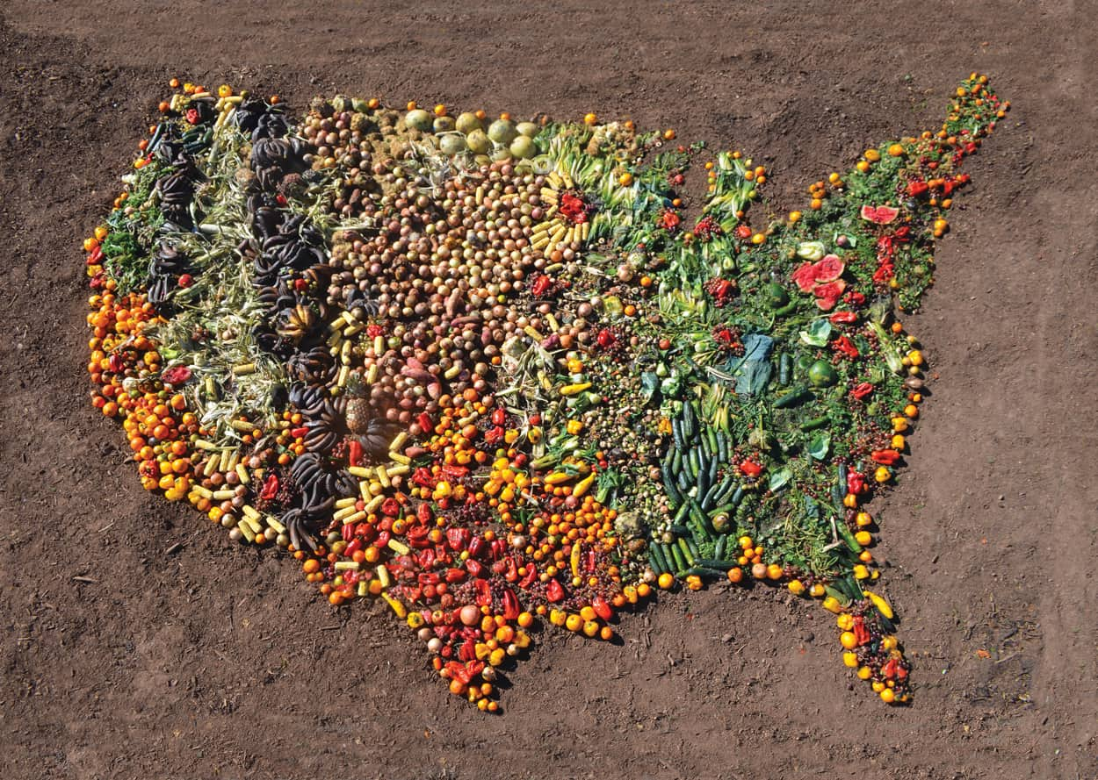
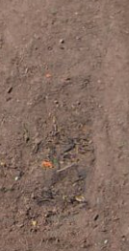
Making a collage –

Slide 25
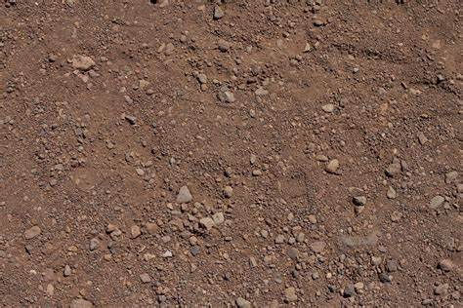

Slide 27
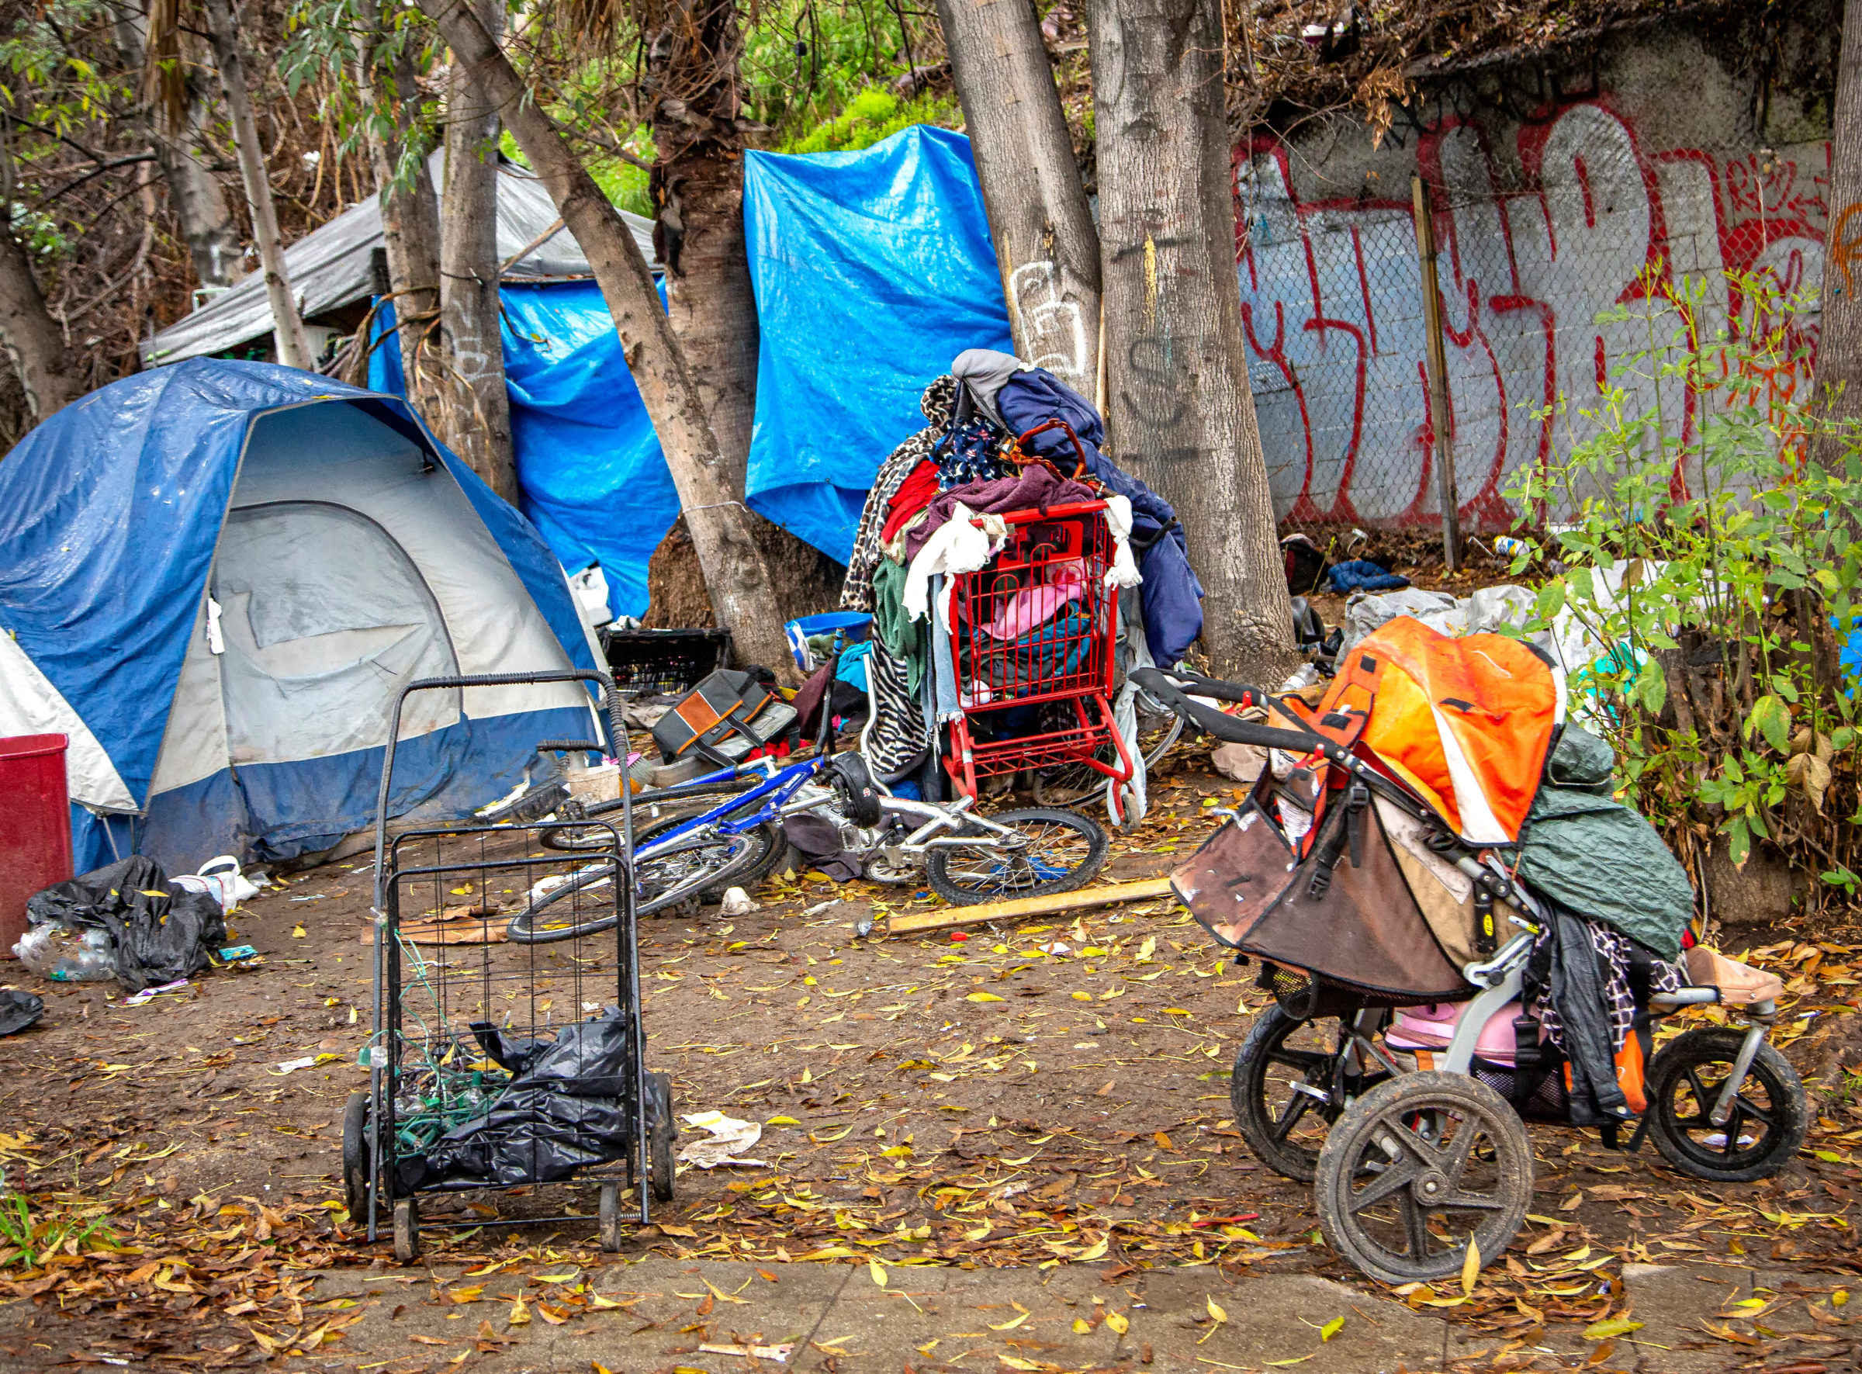
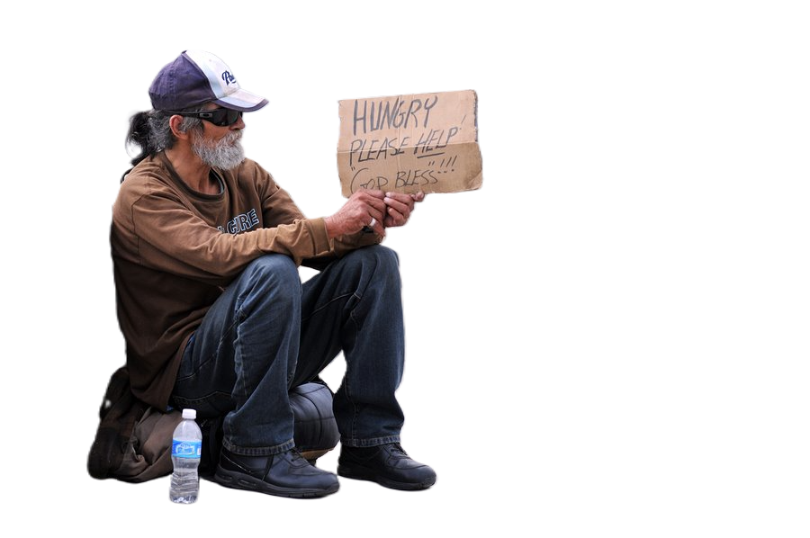
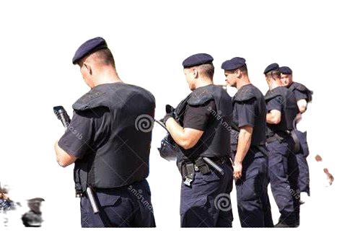
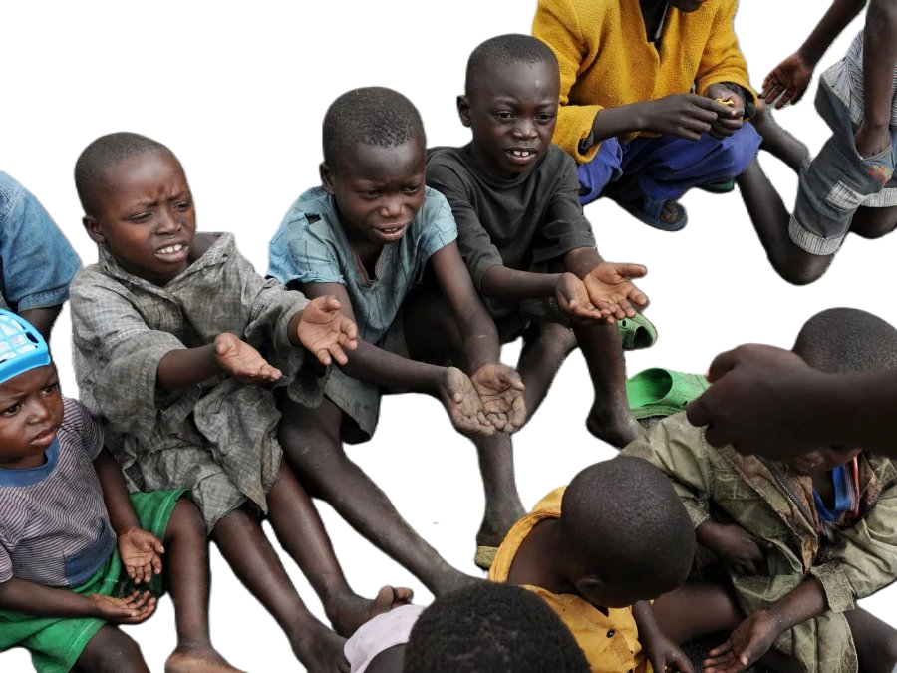

Slide 28
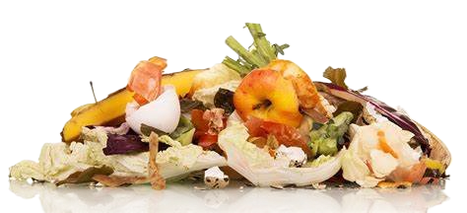

Slide 29
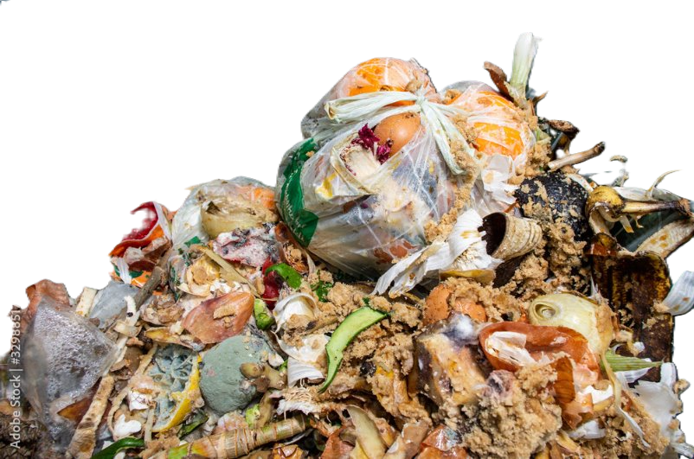

Slide 30
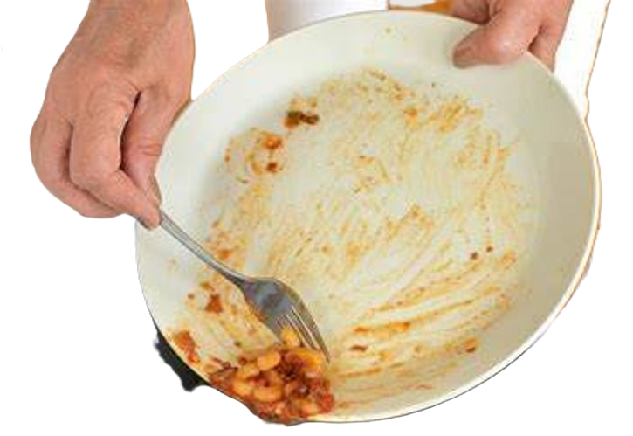

Slide 31




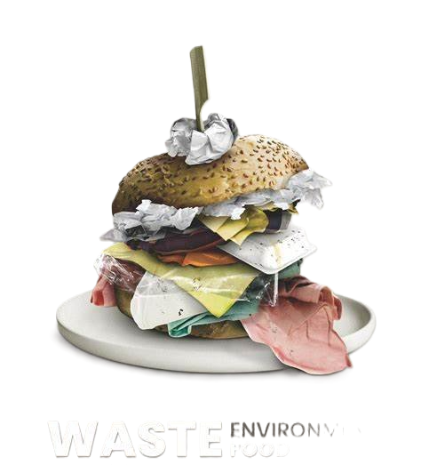
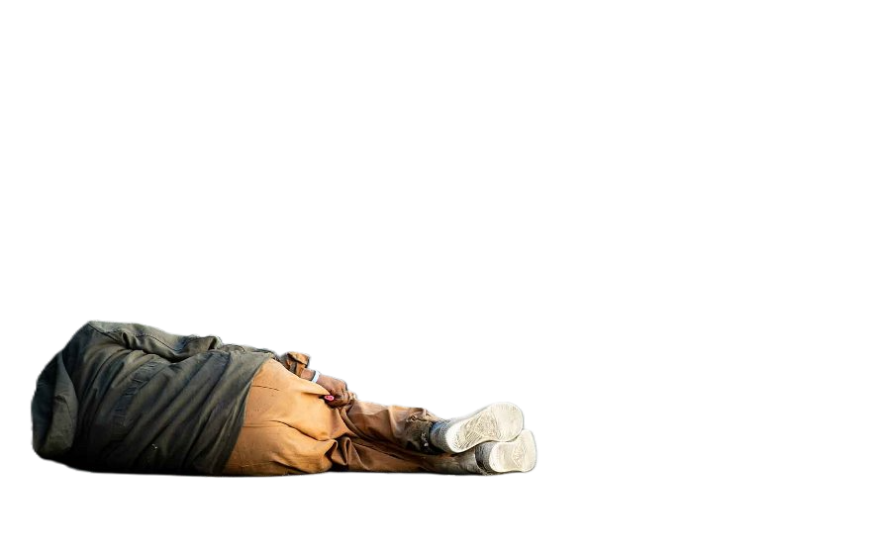
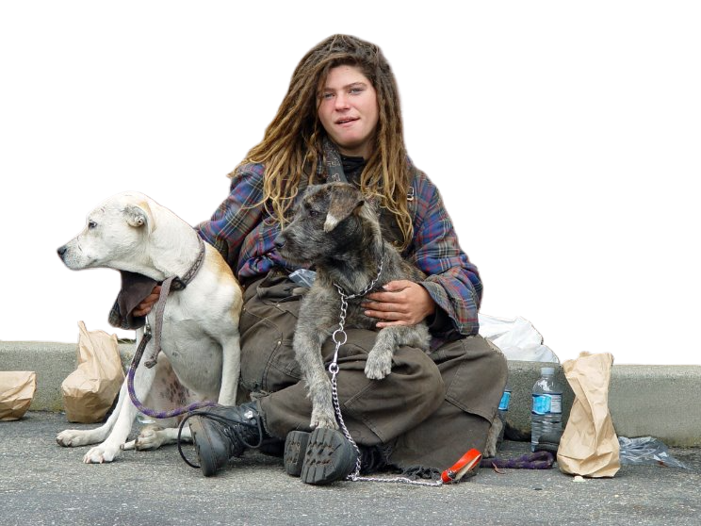



Slide 32

Culture & Collage
Using a variety of materials from construction paper, pen, pencil, collage, or watercolor, create a collage that represents your idea of where you belong.
This should represent your cultural perspective and personal identity.
It can range from something as deep as a social commentary to just a pop art piece!
Project 1:

Slide 33


