Slide 1
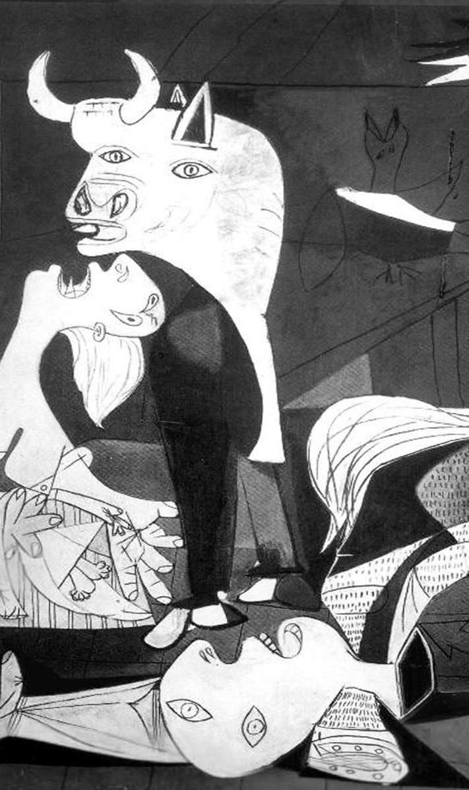
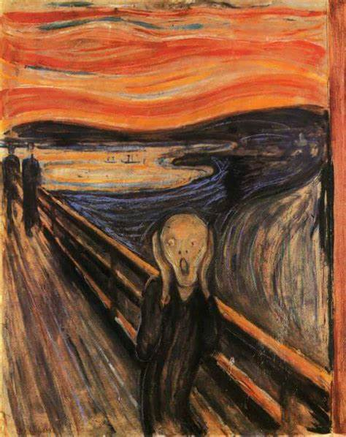
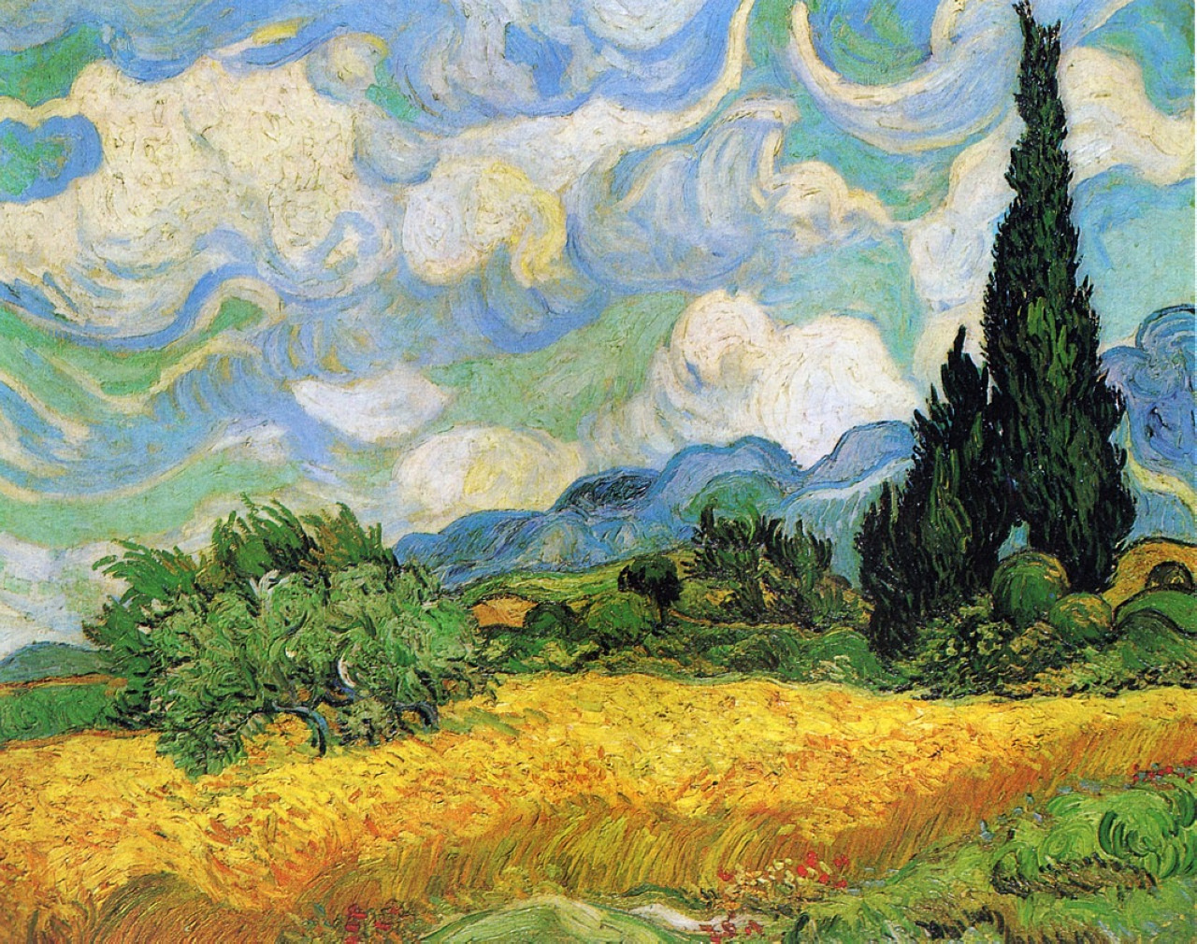
Social emotional learning through art

Slide 2

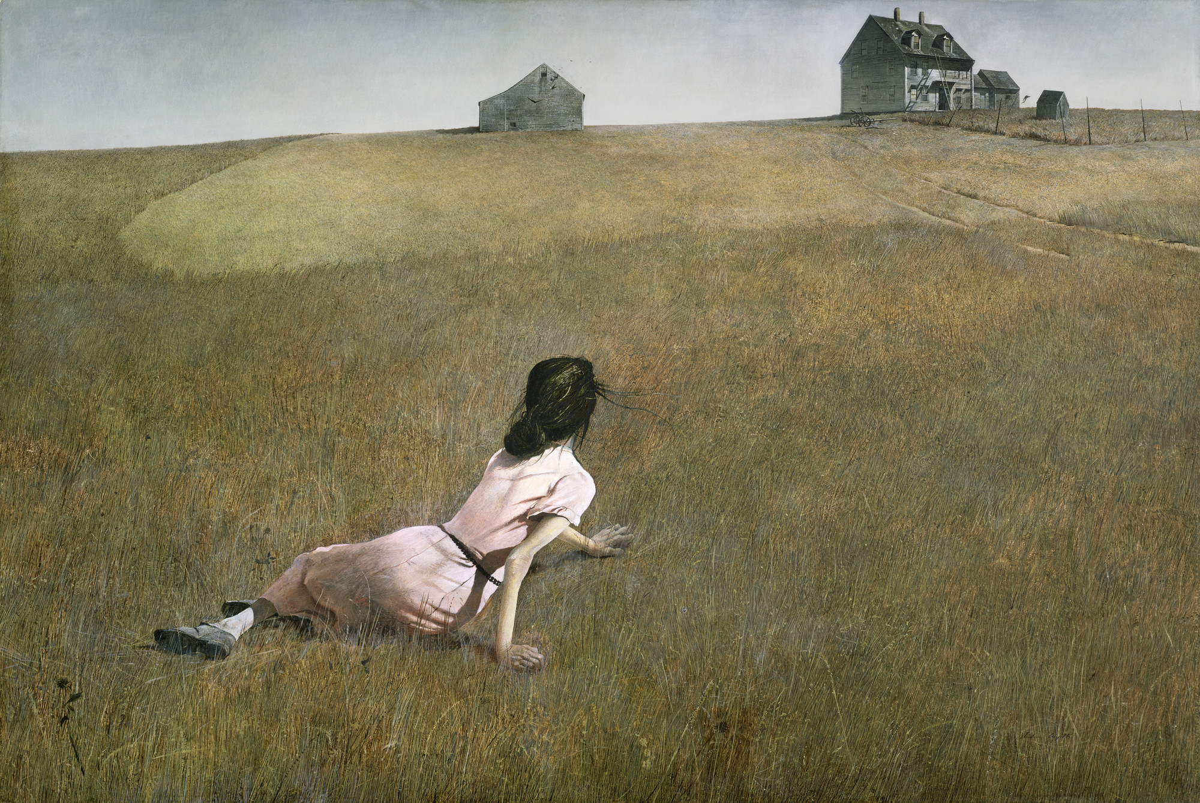
Role of emotional expression through art…
Emotions in art allow artists to connect with their audience on a deeper level. When viewers perceive and resonate with the emotions conveyed in a piece of art, it creates a powerful connection between the creator and the audience.

Slide 3


Role of emotional expression through art…
Emotions serve as a universal language that transcends cultural and linguistic barriers, enabling artists to communicate complex ideas and experiences effectively. By depicting emotions in their work, artists can foster empathy, compassion, and a greater understanding of the human condition

Slide 4
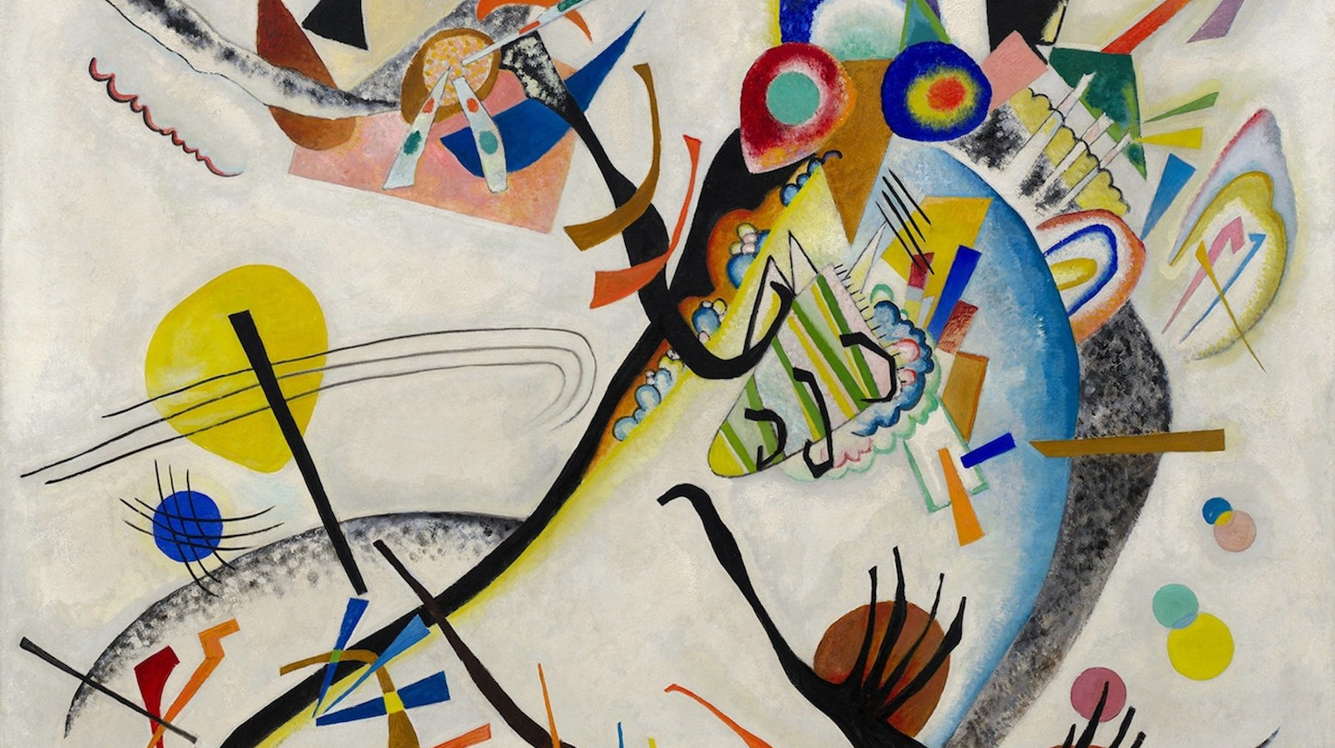
Recognizing emotion in art

Slide 6
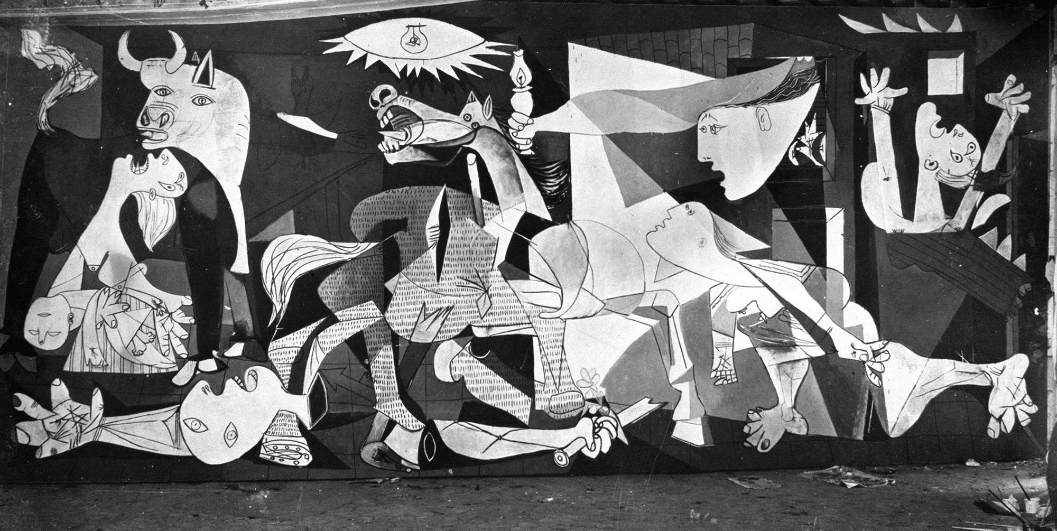

Slide 7

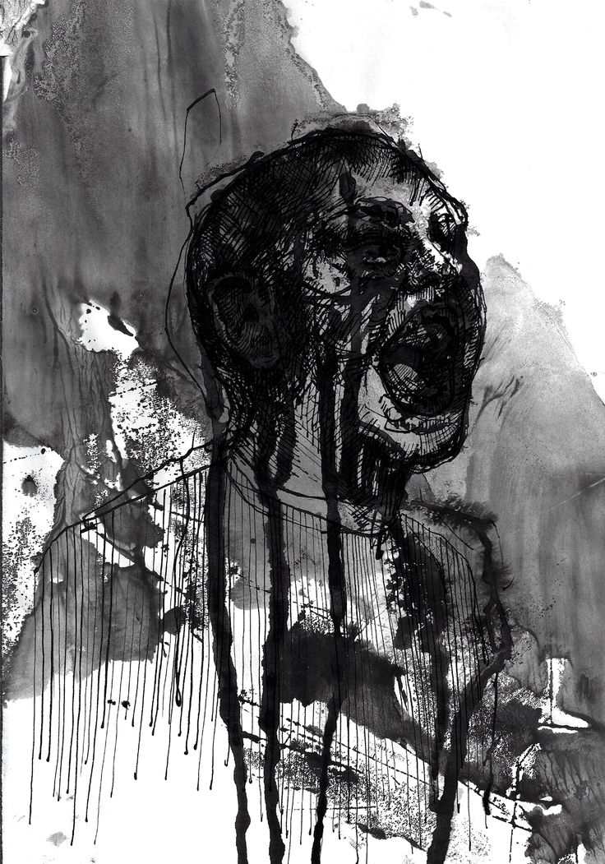
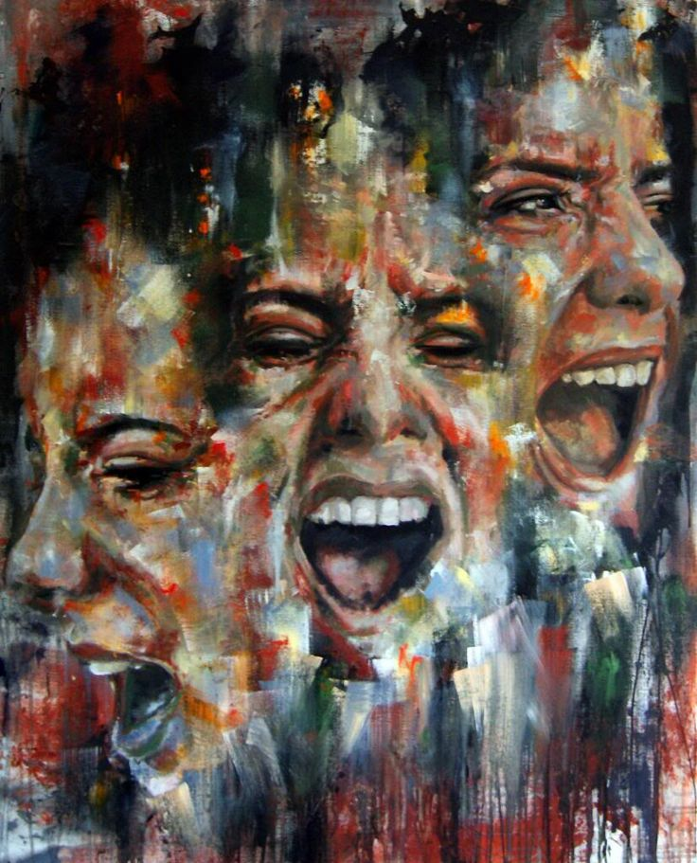

Slide 8
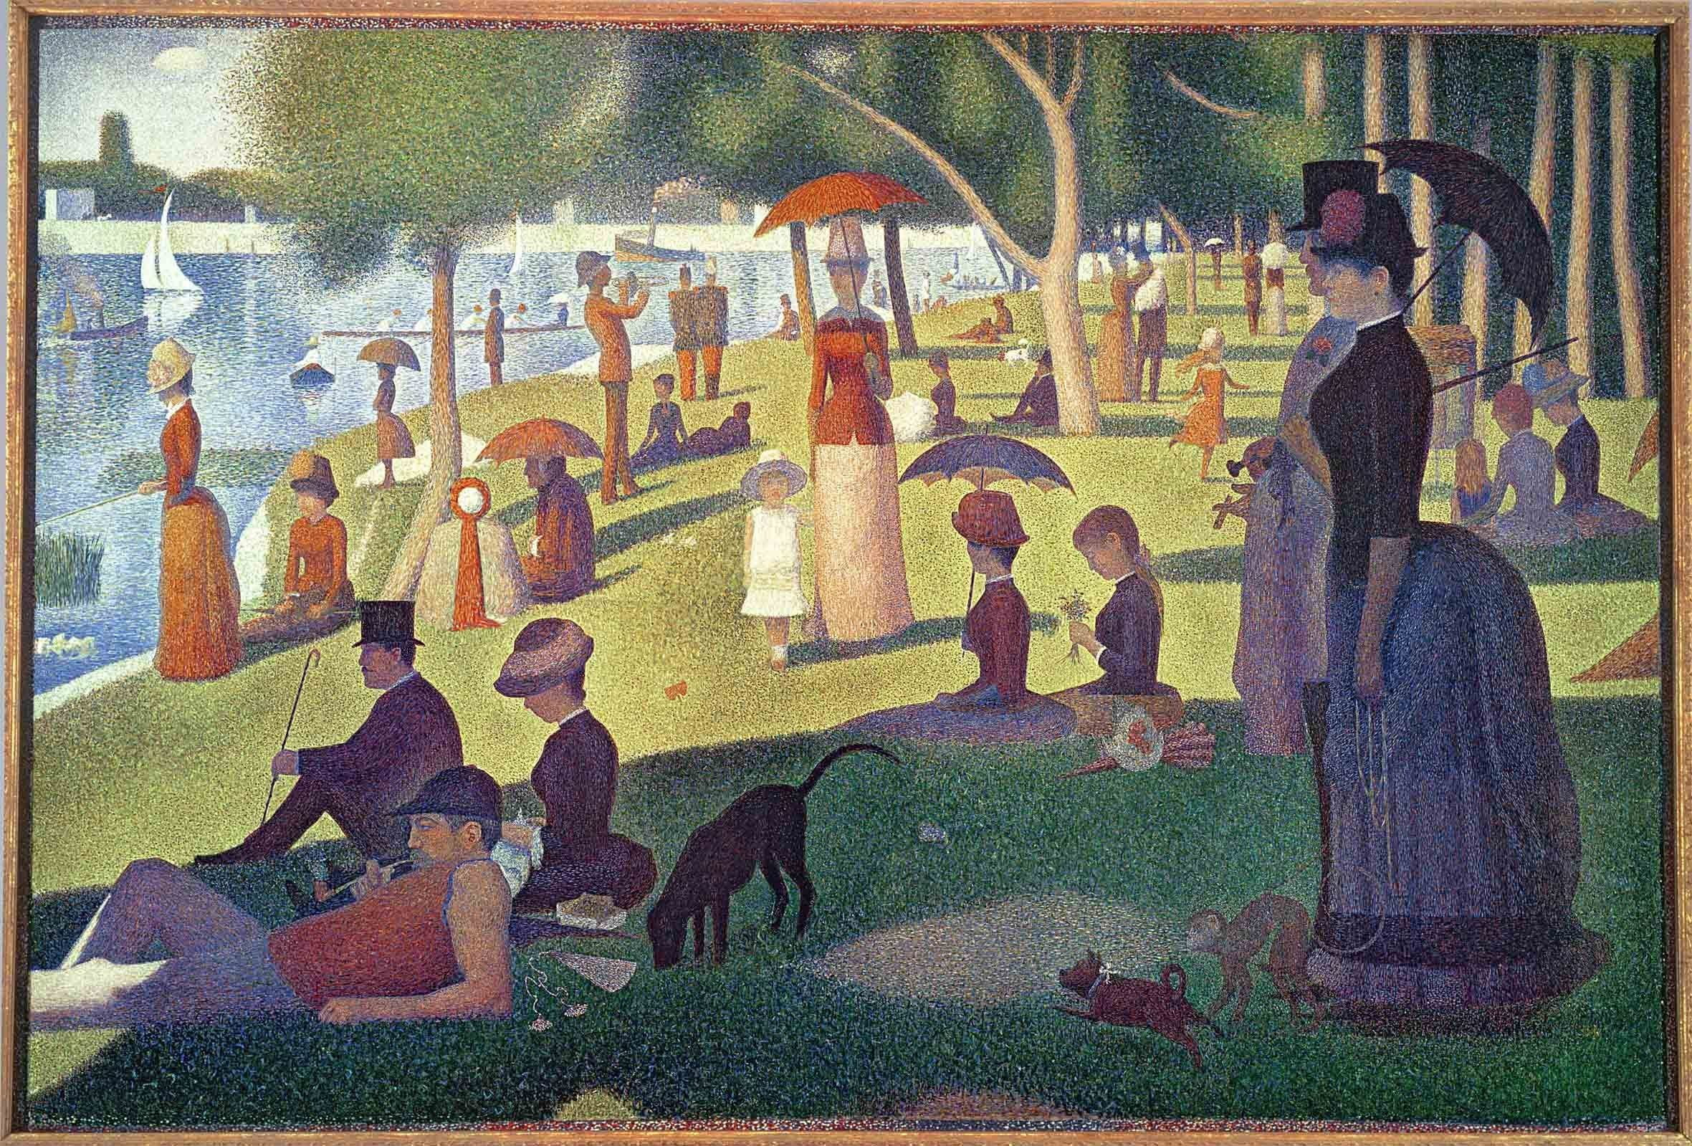

Slide 10
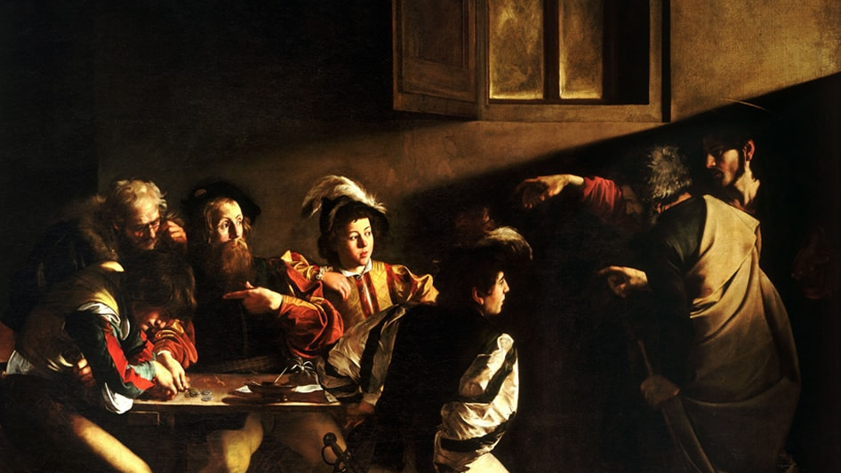
Visualizing emotions
Colors
Warm – Passionate
Cool – Calmness or sadness
Composition
Symmetrical, balanced art – Peaceful
Crowded, chaotic – Anxiety
Lighting/Atmosphere
Bright – Happiness
Dark, deep shadows – Fear, agony
Gestures/Body language
Facial Expressions
Posture
Symbolism/Metaphors
Wilted flowers – Loss
Phoenix – Hope

Slide 11

Exploring emotion in drawing
In your sketchbook, title the page “Sketchbook 10: Drawing Emotion”. Under the title, create a series of sketches and thumbnails expressing a chosen emotion or emotions.
Under the drawings, list the ways/examples in which emotion can be conveyed in art through:
- Color
- Lighting
- Composition
- Body language
- Symbolism
Sketchbook

Slide 12

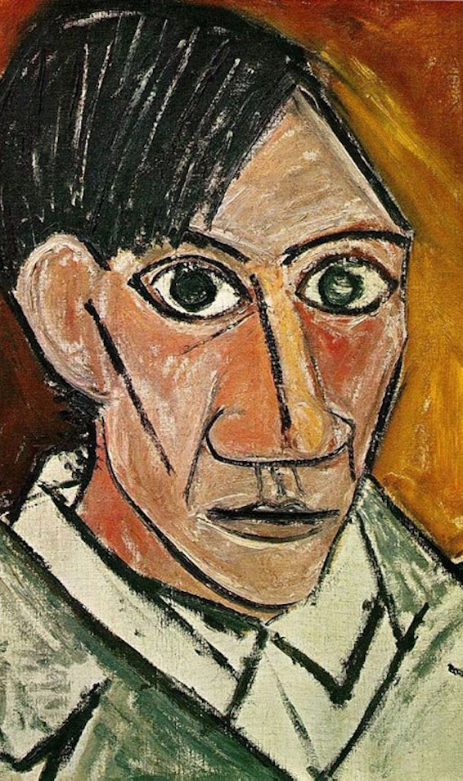
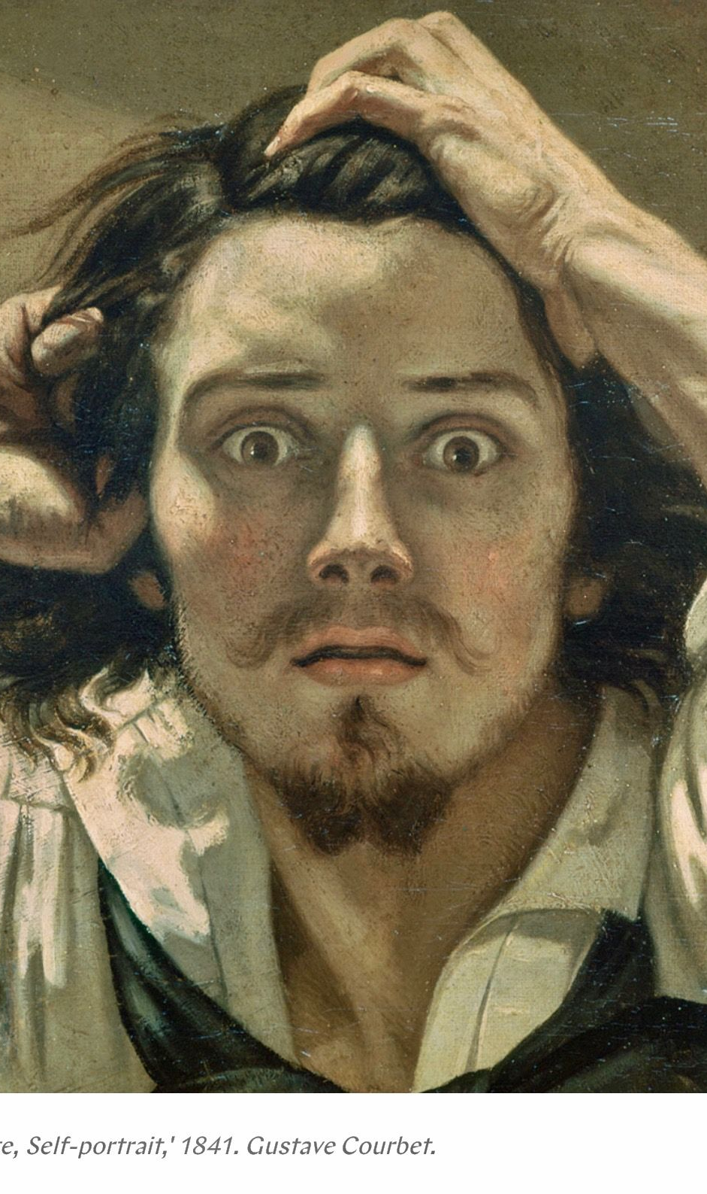
Expressive self-portraiture

Slide 13
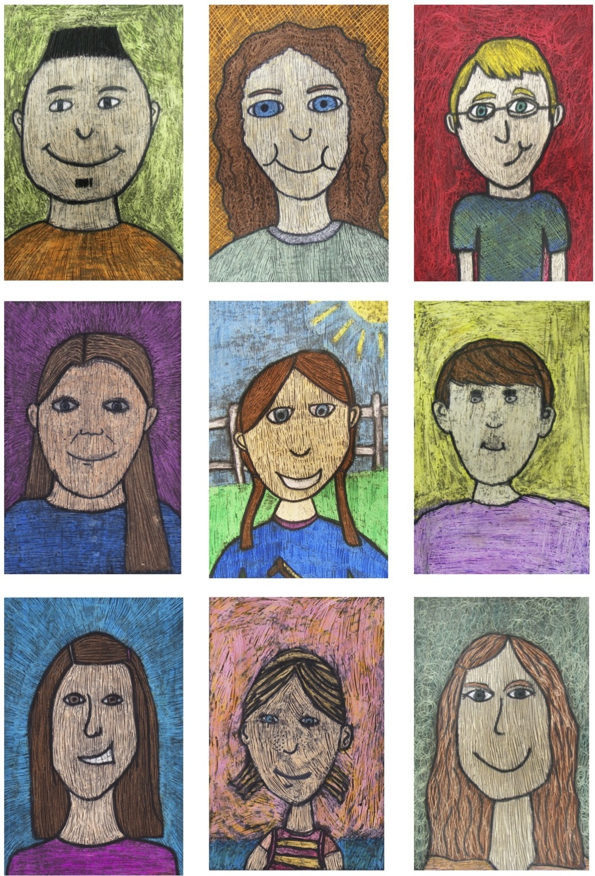
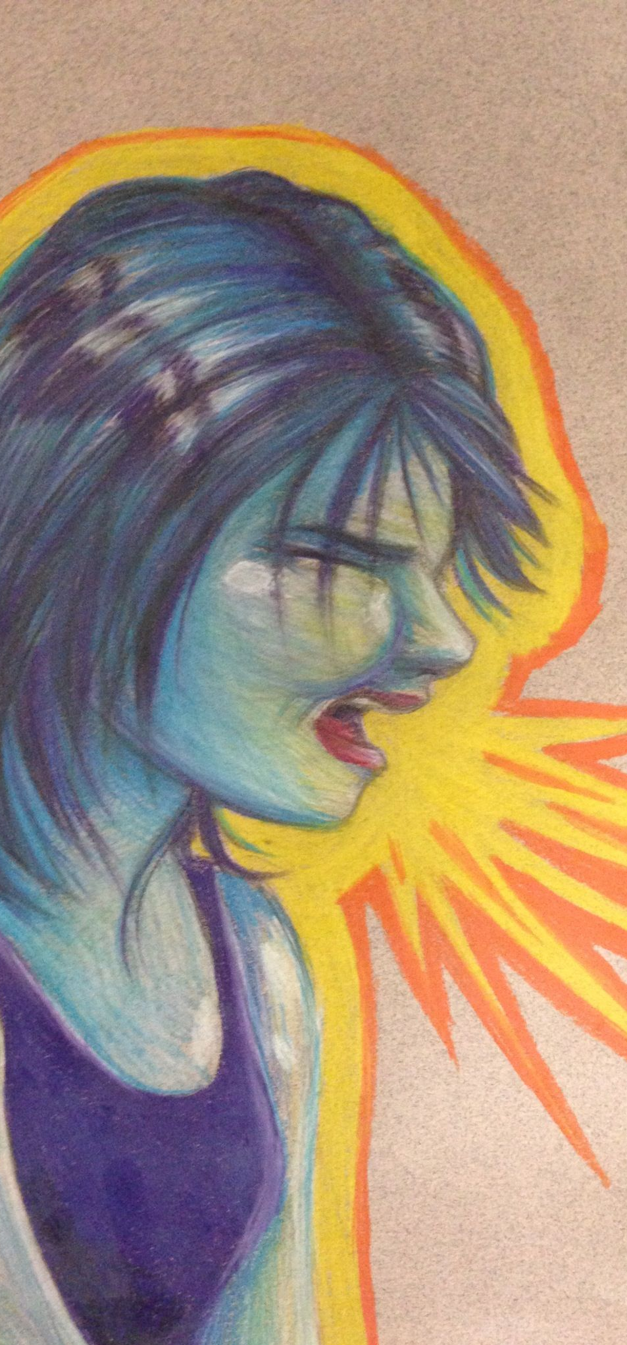
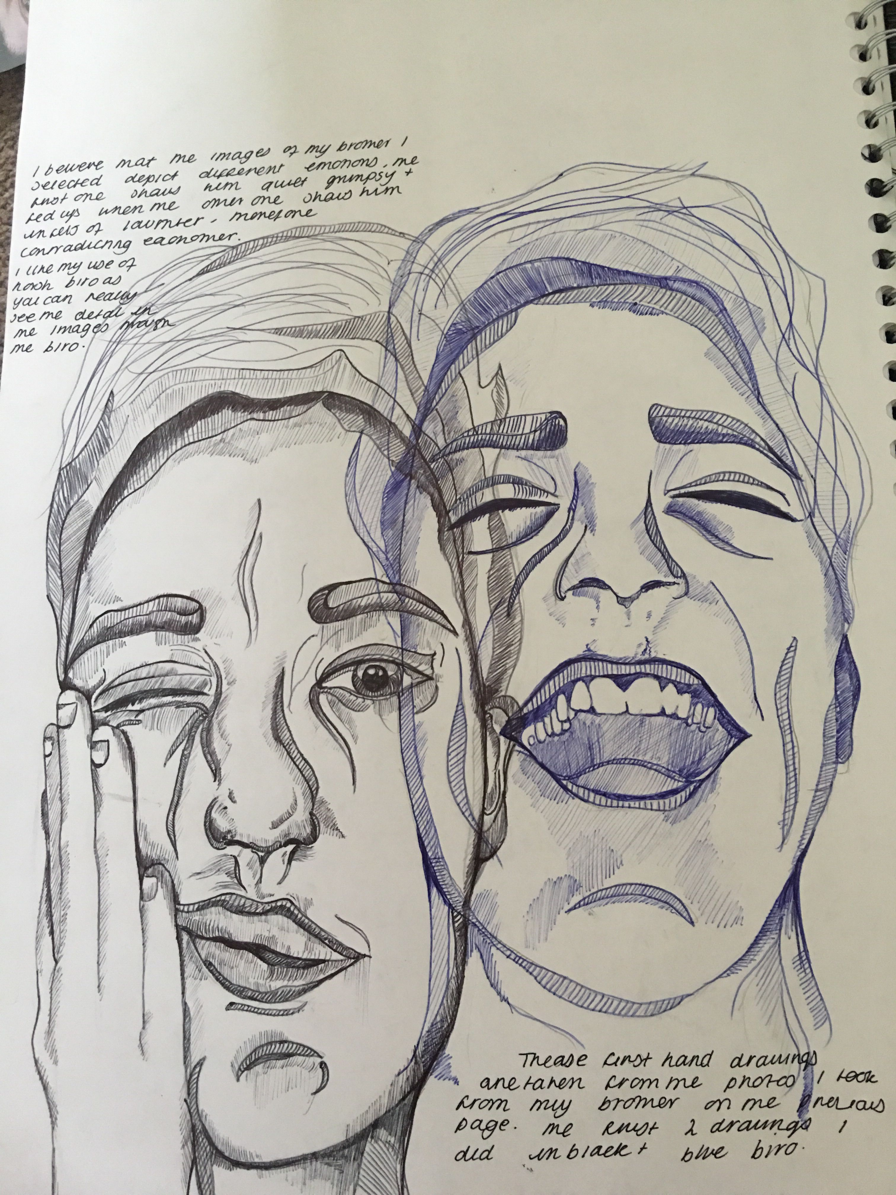
Expressive self portraiture
After creating thumbnails/practicing expressing emotions through drawing, create a pencil self-portrait showing an emotion of your choice. It MUST show an emotion other than just a smile!
When you finish with your drawing, you can choose from colored pencil or watercolor to create a sense of emotion matching your color, for example anger or love could be red, sadness could be greys and blues, etc.
Remember to use aspects of dramatic lighting and composition to compliment the emotion.
Project:

